Slide 1
Where We Are
Studying the absolutely essential ADTs of computer science and classic data structures for implementing them
ADTs so far:
List add, remove, isEmpty, ….
Stack: push, pop, isEmpty, …
Queue: enqueue, dequeue, isEmpty, …
Next:
Binary Search Tree
Priority queue: insert, deleteMin, …
Dictionary/Map: key-value pairs
Set: just keys

Slide 2
Objectives
To become familiar with binary search trees.
To represent binary trees using linked data structures.
To search an element in binary search tree.
To insert an element into a binary search tree.
To traverse elements in a binary tree.
To design and implement the Tree interface and the BST class.
To delete elements from a binary search tree.

Slide 3
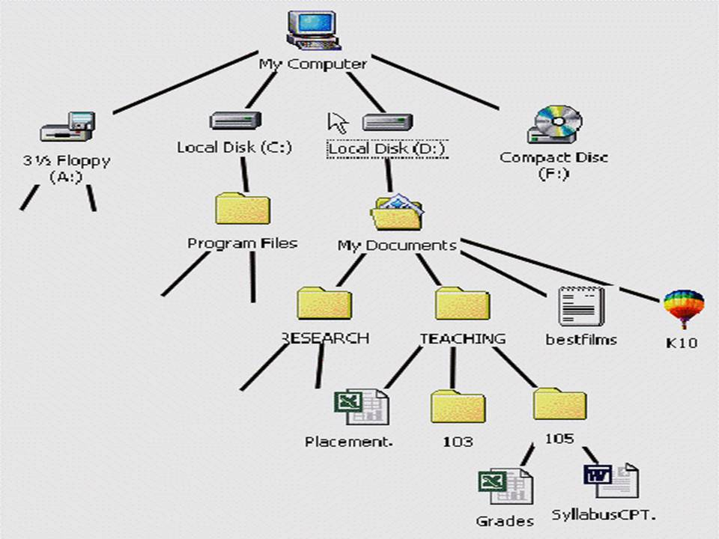
What is a Tree
A list, stack, or queue is a linear structure that consists of a sequence of elements.
In computer science, a tree is an abstract model of a hierarchical structure
A tree consists of nodes with a parent-child relation
Applications:
Organization charts
File systems
Programming environments

Slide 4
Tree Terminology
Root: node without parent (A)
Internal node: node with at least one child (A, B, C, F)
External node (a.k.a. leaf ): node without children (E, I, J, K, G, H, D)
Ancestors of a node: parent, grandparent, grand-grandparent, etc.
Subtree: tree consisting of a node and its descendants
A
subtree
B
C
D
E
F
G
H
I
J
K

Slide 5
Why Trees?
Trees offer speed ups because of their branching factors
Binary Search Trees are structured forms of binary search

Slide 6
Why Trees?
Trees offer speed ups because of their branching factors
Binary Search Trees are structured forms of binary search
Even a basic BST is fairly good
 | Insert | Find | Delete
Worse-Case | O(n) | O(n) | O(n)
Average-Case | O(log n) | O(log n) | O(log n)

Slide 7
Binary Search Trees: A Review

Slide 8
Binary Trees
A non-empty binary tree consists of a
a root (with data)
a left subtree (may be empty)
a right subtree (may be empty)
Representation:
A
B
C
D
E
F
Data
G
H
left
pointer
right
pointer
I
J
Notes:
Alright, we’ll focus today on one type of trees called binary trees.

Slide 9
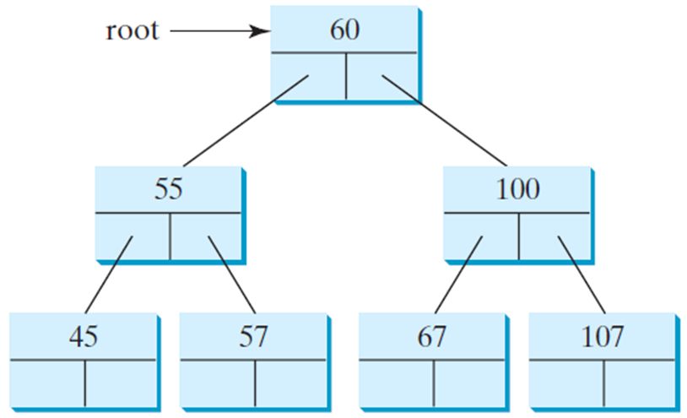
Representing Binary Trees
A binary tree can be represented using a set of linked nodes. Each node contains a value and two links named left and right that reference the left child and right child, respectively, as shown in Figure 25.2.
class TreeNode<E> {
E element;
TreeNode<E> left;
TreeNode<E> right;
public TreeNode(E o) {
element = o;
}
}

Slide 10
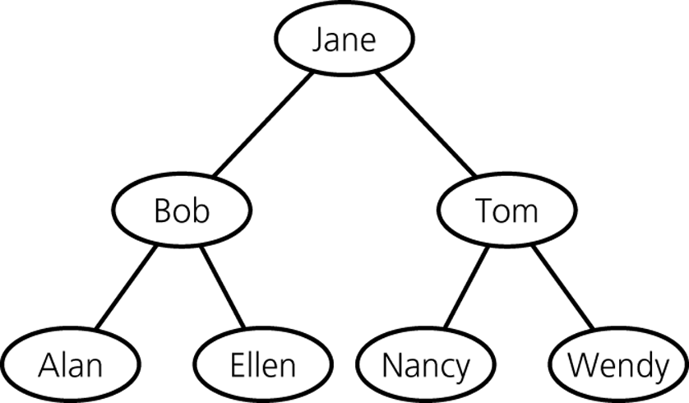
Terminology
BSTs are binary trees with the following added criteria:
Each node has a key for comparing nodes
Keys in left subtree are smaller than node’s key
Keys in right subtree are larger than node’s key
Both T_{L} and T_{R} are binary search trees
A binary search tree of names
Notes:
A special type of binary tree called a binary search tree is often useful. A binary search tree (with no duplicate elements) has the property that for every node in the tree the value of any node in its left subtree is less than the value of the node and the value of any node in its right subtree is greater than the value of the node.

Slide 11
Binary Search Trees
Why Use Binary Search Tree
It combines the advantages of two other structures.
Ordered array
Linked list
Notes:
With ordered arrays, we saw the binary search algorithm O(log n). We can do the same with binary trees
With linked list we saw the insertion and deletion can be done quickly without shifting elements. Same is true with binary trees.

Slide 12
Arithmetic Expression Tree
Binary tree associated with an arithmetic expression
internal nodes: operators
external nodes: operands
Example: arithmetic expression tree for the expression (2 × (a − 1) + (3 × b))
+
×
×
2
−
3
b
a
1

Slide 13
Terminology
The length of a path
Is the number of the nodes in the path.
The depth of a node
Is the length of the path from the root to the node.
Level of a node n in a tree T
Is the depth of n
A
B
C
D
E
F
G
H
I
J

Slide 14
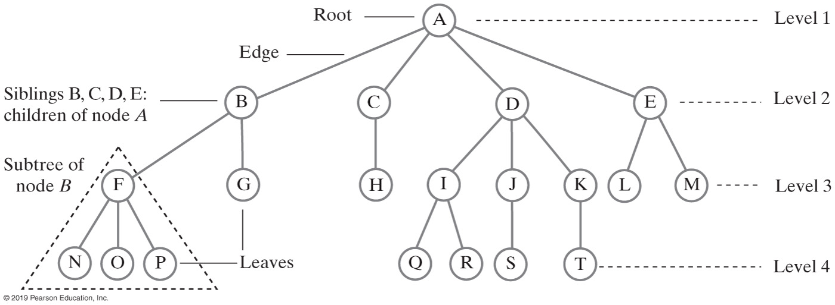

Slide 15
Terminology
The height of trees
Level of a node n in a tree T
If n is the root of T, it is at level 1
If n is not the root of T, its level is 1 greater than the level of its parent
Height of a tree T defined in terms of the levels of its nodes
If T is empty, its height is 0
If T is not empty, its height is equal to the maximum level of its nodes

Slide 16
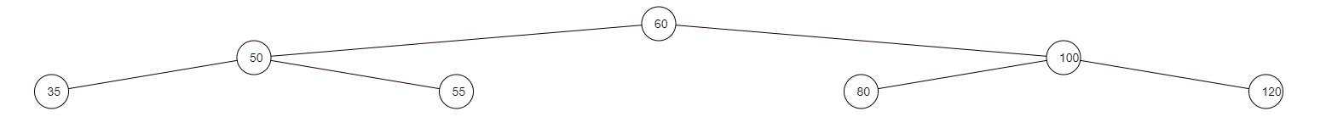
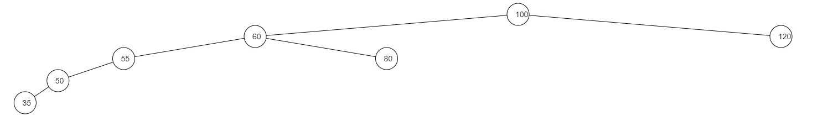
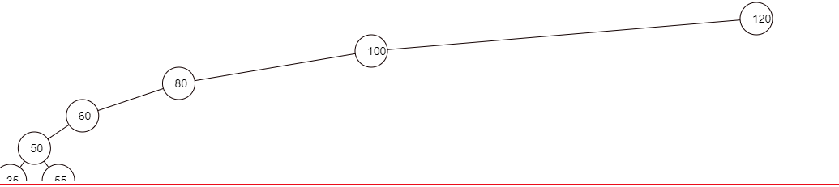
Terminology
Binary trees with the same nodes but different heights

Slide 17
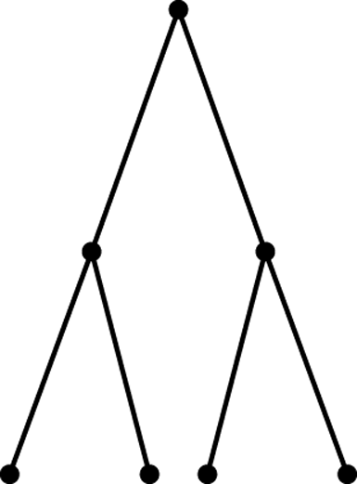
Terminology
Full, complete, and balanced binary trees
Recursive definition of a full binary tree
If T is empty, T is a full binary tree of height -1
If T is not empty and has height h > -1, T is a full binary tree if its root’s subtrees are both full binary trees of height h – 1
A full binary tree of height 3

Slide 18
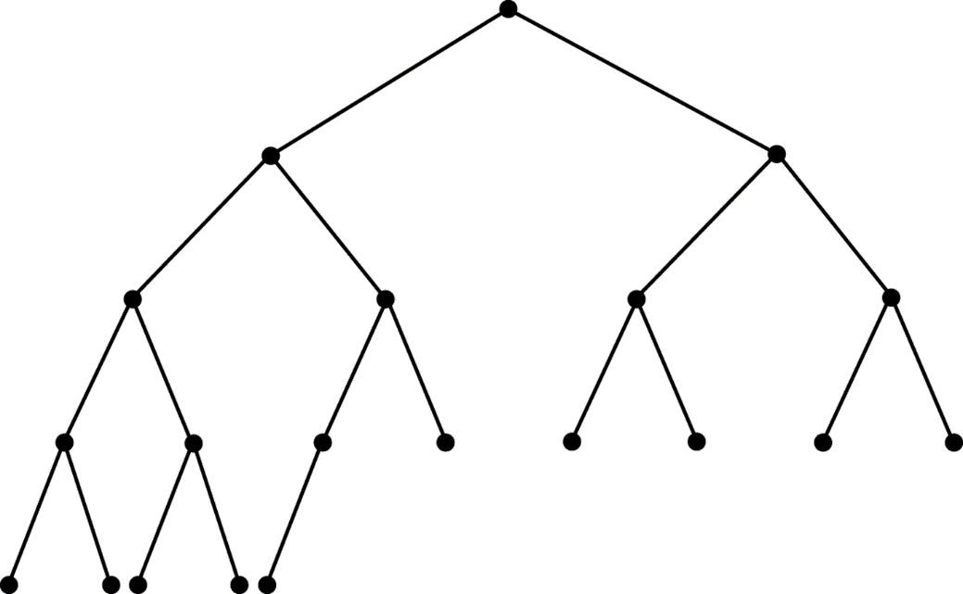
Terminology
Complete binary trees
A binary tree T of height h is complete if
All nodes at level h – 2 and above have two children each, and
When a node at level h – 1 has children, all nodes to its left at the same level have two children each, and
When a node at level h – 1 has one child, it is a left child
A complete binary tree

Slide 19
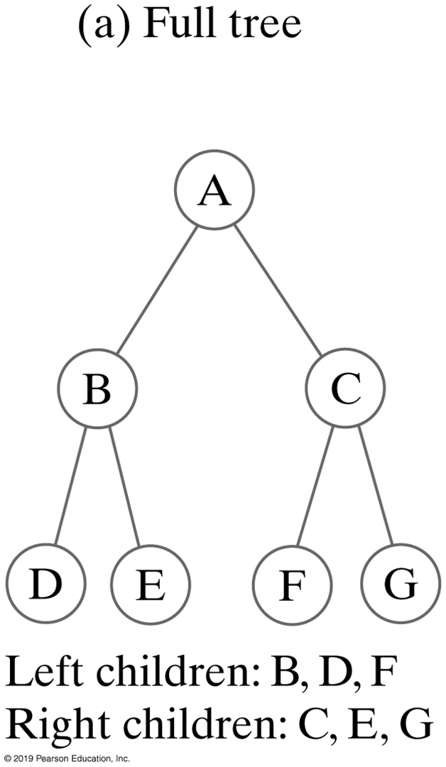
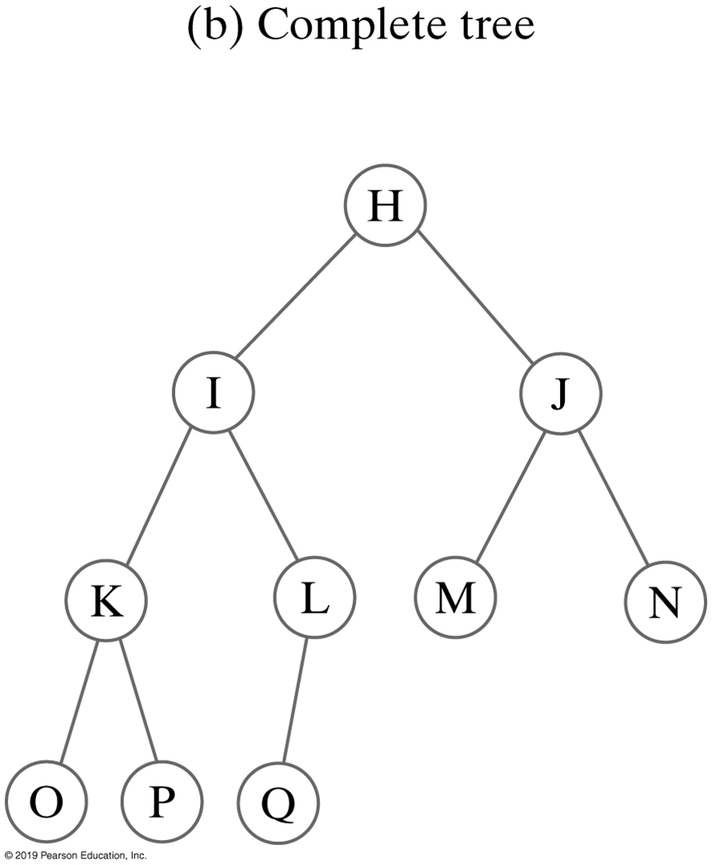
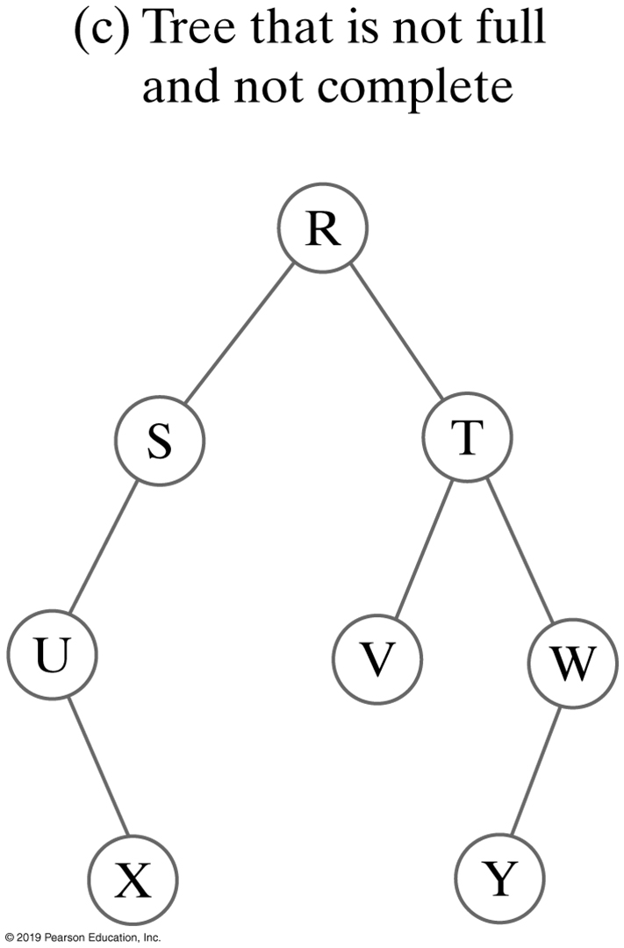
Binary Trees

Slide 20
Terminology
Balanced binary trees
A binary tree is balanced if the height of any node’s right subtree differs from the height of the node’s left subtree by no more than 1
Full binary trees are complete
Complete binary trees are balanced

Slide 21
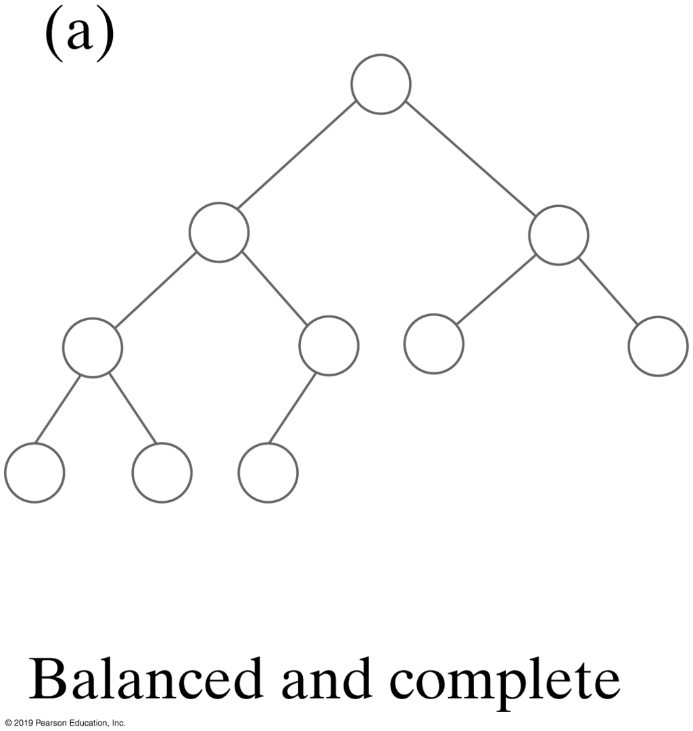
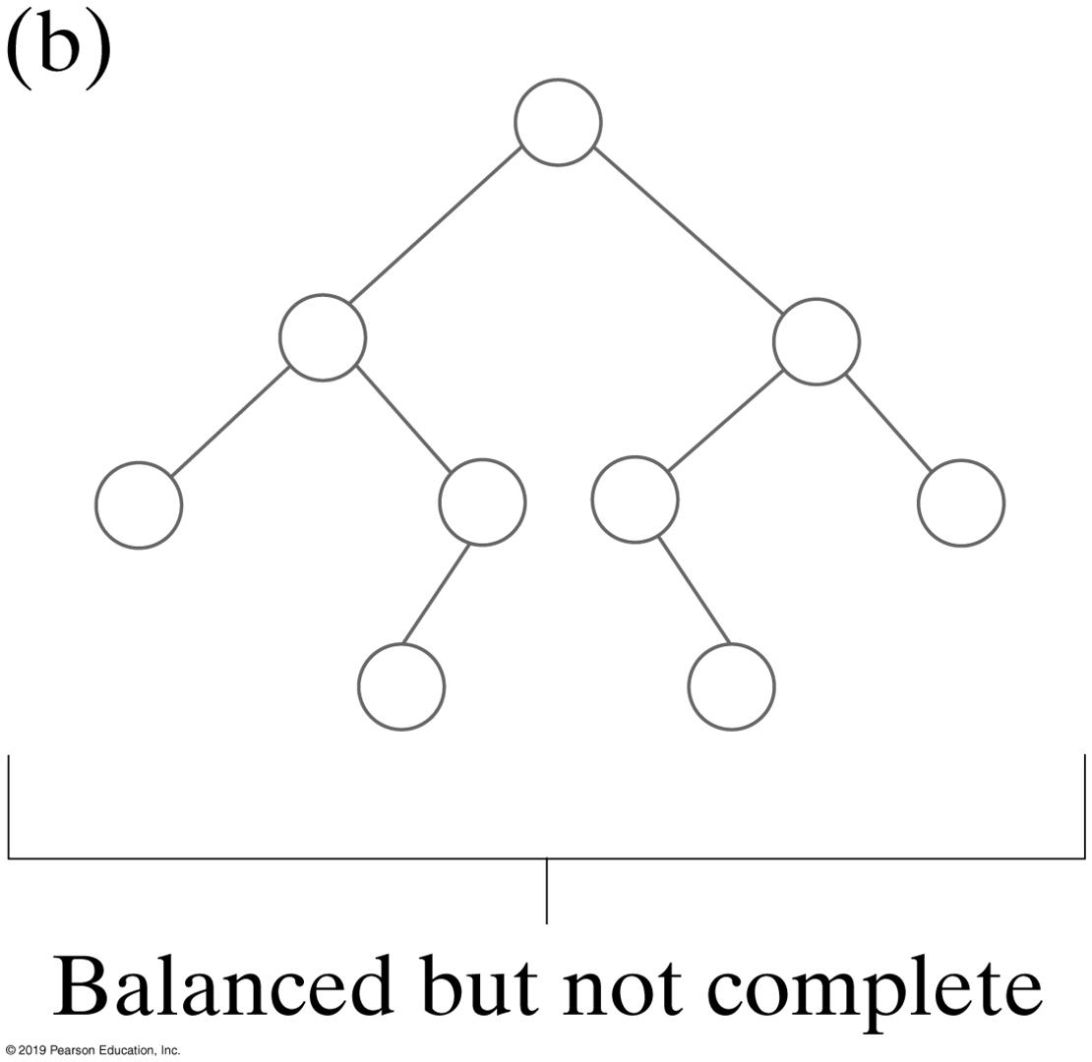
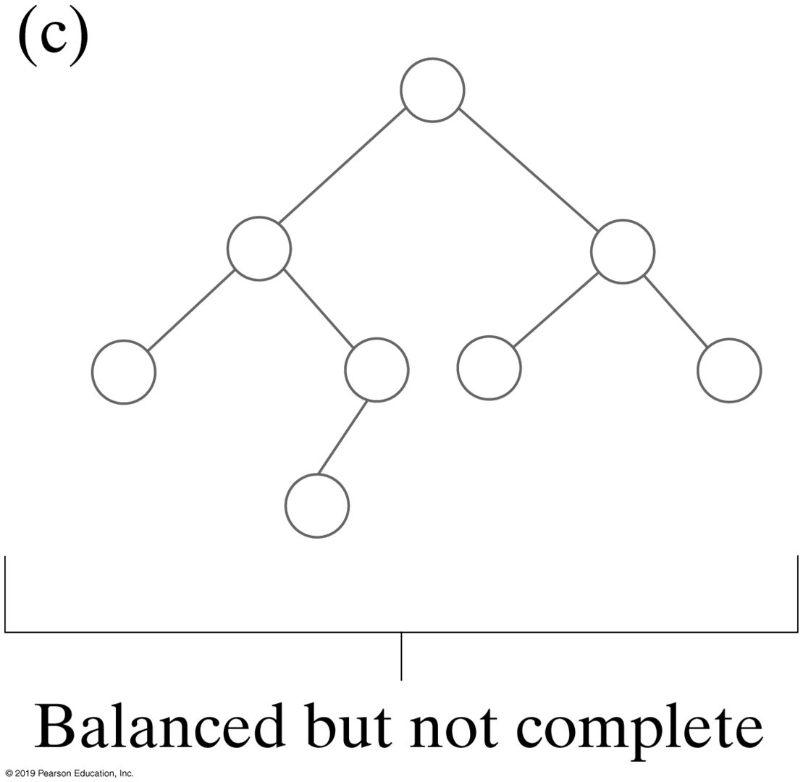
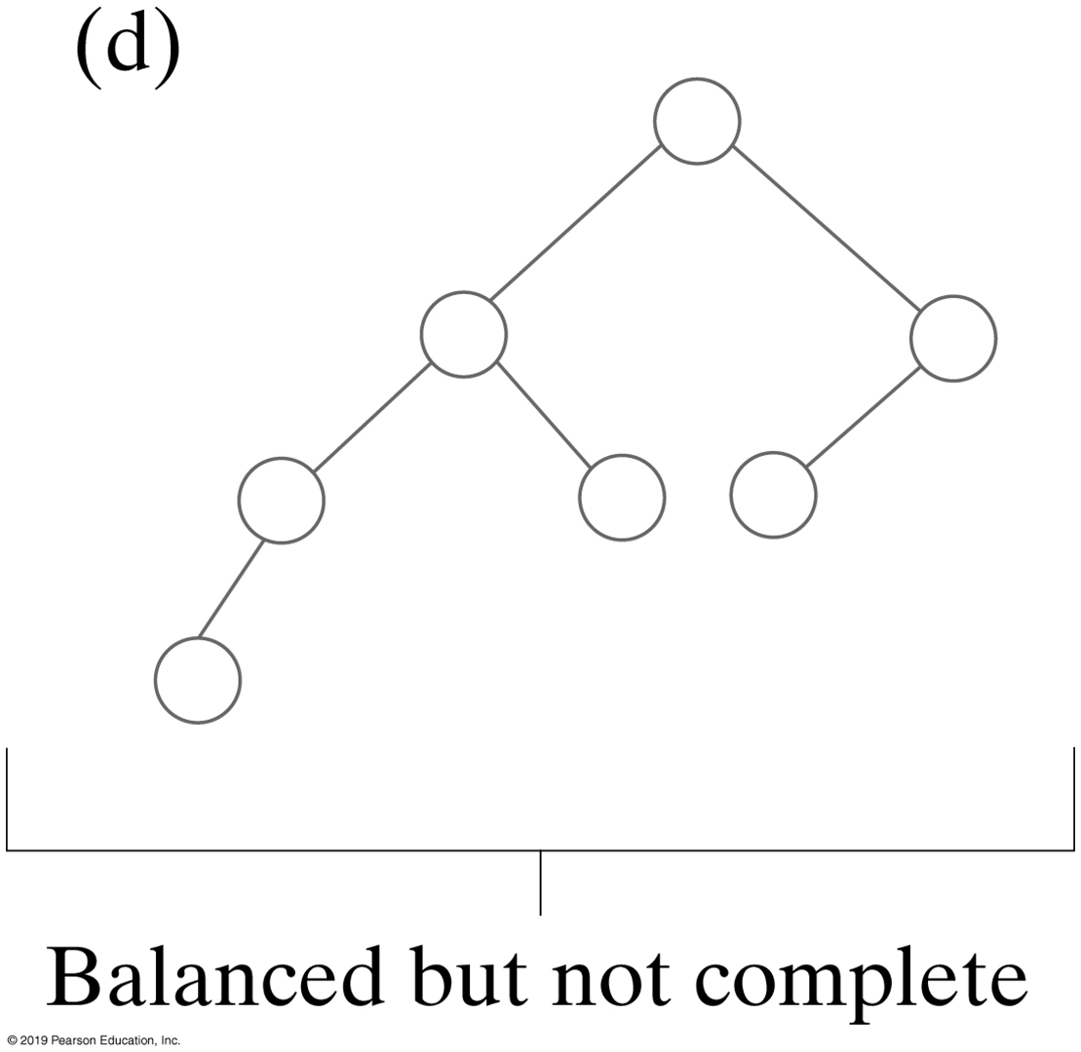
Binary Trees
Balanced, but not complete

Slide 22
Are these BSTs?
5
8
4
8
5
11
1
7
11
2
7
6
10
18
3
4
All children must obey order
15
20
21
Notes:
Why is the one on the left a BST? It’s not complete!
(B/c BSTs don’t need to be complete)
Why isn’t the one on the right a BST?
Three children of 5
20 has a left child larger than it.
What’s wrong with 11?
Even though 15 isn’t a direct child, it _still_ needs to be less than 11!

Slide 23
Tree Traversal (1 of 5)
Tree traversal is the process of visiting each node in the tree exactly once. There are several ways to traverse a tree. This section presents DFS & BFS:
Depth-first search (DFS)
The algorithm begins at the root node and then it explores each branch before backtracking. It is implemented using stacks.
Recursion is used for backtracking.
For Binary trees, there are three types of DFS traversals.
In-Order
Pre-Order
Post-Order

Slide 24
Tree Traversal (2 of 5)
The inorder traversal is to visit the left subtree of the current node first recursively, then the current node itself,
and finally the right subtree of the
current node recursively.

Slide 25
Tree Traversal (3 of 5)
The preorder traversal is to visit the current node first, then the left subtree of the current node recursively, and finally the right subtree of the current node recursively.

Slide 26
Tree Traversal (4 of 5)
The postorder traversal is to visit the left subtree of the current node first recursively, then the right subtree of the
current node recursively, and finally the current node itself.

Slide 27
Tree Traversal (5 of 5)
Breadth-First Search (BFS)
The breadth-first traversal is to visit the nodes level by level. First, visit the root, then all children of the root from left to right, then grandchildren of the root from left to right, and so on.

Slide 28
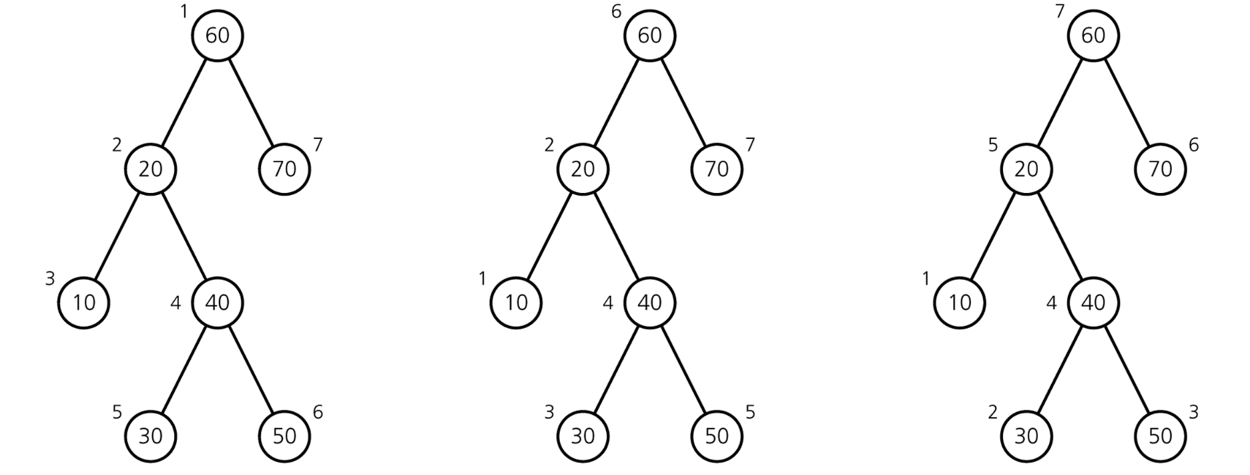
Traversal of a Binary Tree
Traversals of a binary tree: preorder; inorder; postorder

Slide 29
Check Point
Traverse
Inorder
Preorder
Postorder
30
20
70
10
50
90
40
60

Slide 30
Check Point
Consider the following BST. The numbers simply label the nodes so that you can reference them; they do not indicate the contents of the nodes.
1
2
3
5
6
7
4
8
9
Which node must contain the inorder successor of the value in the root
In what order will an inorder traversal visit the nodes of this tree?

Slide 31

Representing Binary Trees
A binary tree can be represented using a set of linked nodes. Each node contains a value and two links named left and right that reference the left child and right child, respectively.
class TreeNode<E> {
E element;
TreeNode<E> left;
TreeNode<E> right;
public TreeNode(E o) {
element = o;
}
}

Slide 32
The Tree Interface
The Tree interface defines common operations for trees.

Slide 33
The BST Class
Let’s define the binary tree class, named BST with A concrete BST class can be defined to extend AbstractTree.

Slide 34
Search in BST, Iterative
12
public boolean search(E element) {
TreeNode<E> current = root; // Start from the root
while (current != null)
if (element < current.element) {
current = current.left; // Go left
}
else if (element > current.element) {
current = current.right; // Go right
}
else // Element matches current.element
return true; // Element is found
return false; // Element is not in the tree
}
5
15
2
9
20
7
10
17
30
Notes:
public boolean find(E e) {
return find(e,root);
}
public boolean find(E e, TreeNode<E> current) {
if(current==null)
return false;
else if(current.element.equals(e))
return true;
else if(e.compareTo(current.element)<0)
return find(e,current.left);
else
return find(e,current.right);
}

Slide 35
Search in BST, Recursive
12
5
15
2
9
20
7
10
17
30
Notes:
public boolean find(E e) {
return find(e,root);
}
public boolean find(E e, TreeNode<E> current) {
if(current==null)
return false;
else if(current.element.equals(e))
return true;
else if(e.compareTo(current.element)<0)
return find(e,current.left);
else
return find(e,current.right);
}

Slide 36

Insert in BST
12
The code for insert is the same as with search except you add a node when you fail to find it.
What makes it easy is that inserts only happen at the leaves.
5
15
2
9
13
20
7
10
17
30
8
31
Notes:
Let’s do some inserts:
insert(8)
insert (11)
insert(31)

Slide 37
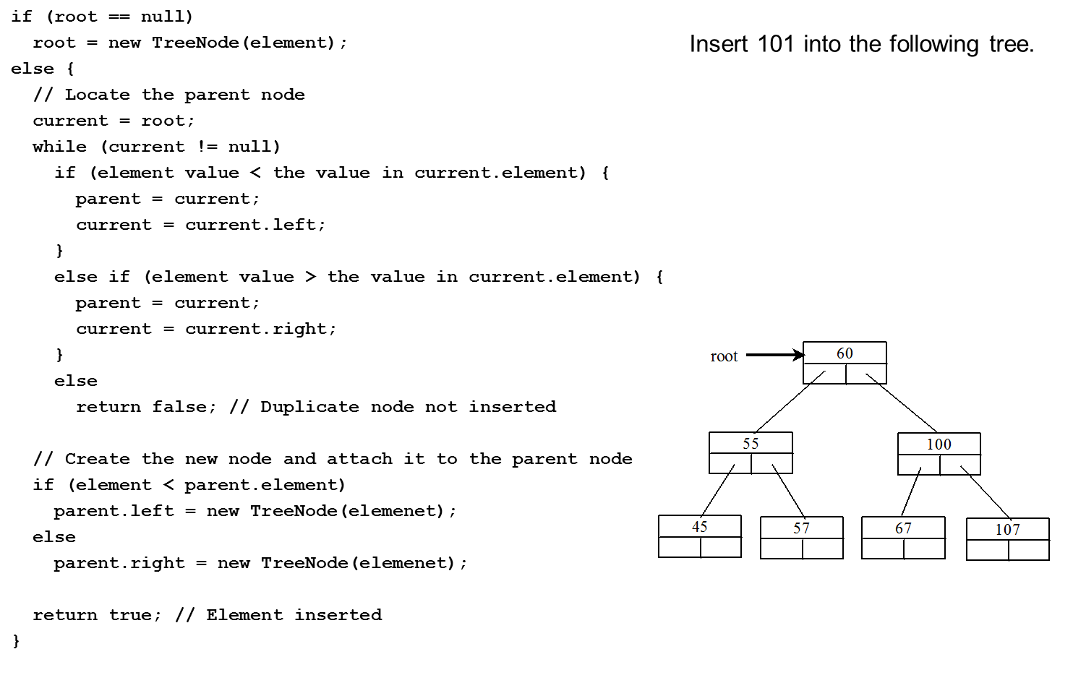
Inserting an Element to a Binary Tree
Notes:
root = new TreeNode left parenthesis element right parenthesis semi colon
else left brace
foward slash foward slash Locate the parent node
current = root semi colon
while left parenthesis current exclamation mark = null right parenthesis
if left parenthesis element value less than symbol the value in current.element right parenthesis left brace
parent = current semi colon
current = current.left semi colon
right brace
else if left parenthesis element value greater than symbol the value in current.element right parenthesis left brace
parent = current semi colon
current = current.right semi colon
right brace
else
return false semi colon foward slash foward slash Duplicate node not inserted
foward slash foward slash Create the new node and attach it to the parent node
if left parenthesis element less than symbol parent.element right parenthesis
parent.left = new TreeNode left parenthesis elemenet right parenthesis semi colon
else
parent.right = new TreeNode left parenthesis elemenet right parenthesis semi colon
return true semi colon foward slash foward slash Element inserted
right brace
Insert 101 into the following tree.
A tree diagram shows 60 at the top labeled, root. 60 has branches as 55 and 100. 55 has branches as 45 and 57. 100 has branches as 67 and 107.

Slide 38
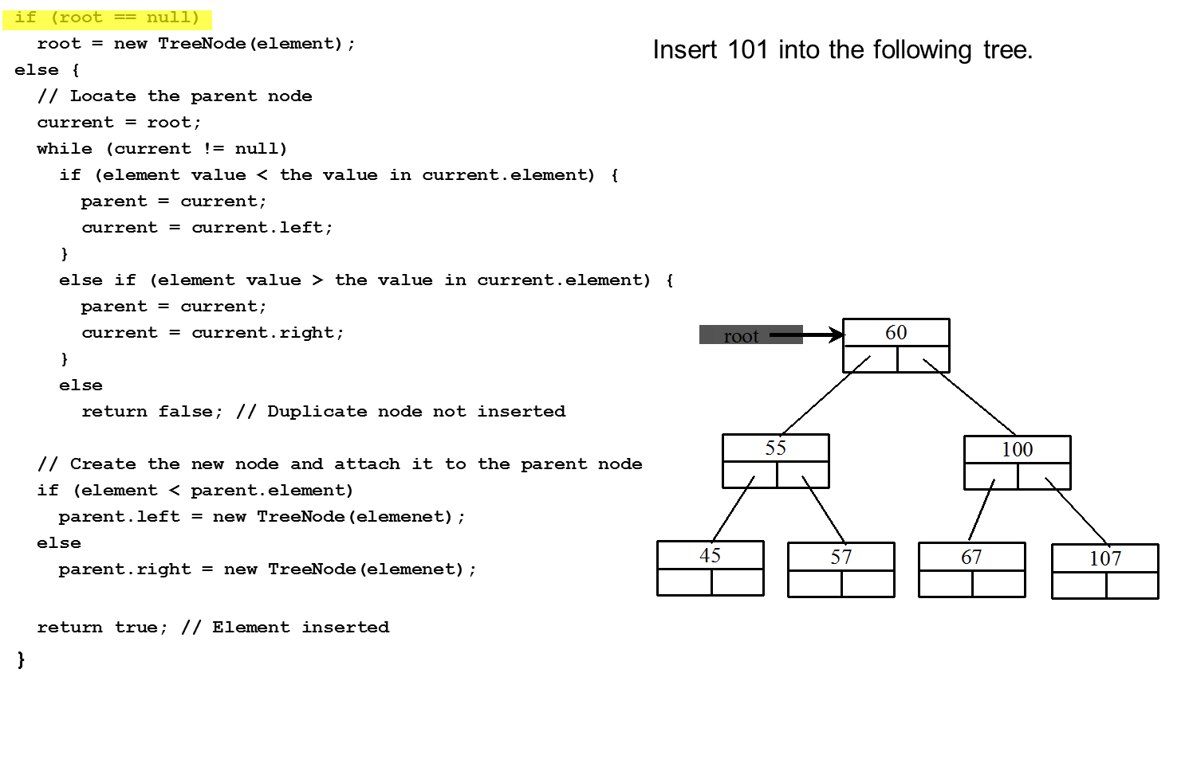
Trace Inserting 101 into the following tree (1 of 20)
Notes:
root = new TreeNode left parenthesis element right parenthesis semi colon
else left brace
foward slash foward slash Locate the parent node
current = root semi colon
while left parenthesis current != null right parenthesis
if left parenthesis element value less than symbol the value in current.element right parenthesis left brace
parent = current semi colon
current = current.left semi colon
right brace
else if left parenthesis element value greater than symbol the value in current.element right parenthesis left brace
parent = current semi colon
current = current.right semi colon
right brace
else
return false semi colon foward slash foward slash Duplicate node not inserted
foward slash foward slash Create the new node and attach it to the parent node
if left parenthesis element less than symbol parent.element right parenthesis
parent.left = new TreeNode left parenthesis elemenet right parenthesis semi colon
else
parent.right = new TreeNode left parenthesis elemenet right parenthesis semi colon
eturn true semi colon foward slash foward slash Element inserted
right brace
The first row is highlighted.
Insert 101 into the following tree.
A tree diagram shows 60 at the top labeled, root. 60 has branches as 55 and 100. 55 has branches as 45 and 57. 100 has branches as 67 and 107.

Slide 39
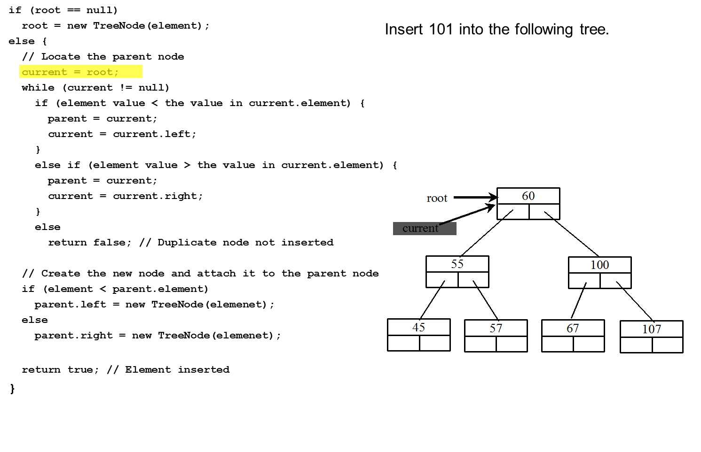
Trace Inserting 101 into the following tree (2 of 20)
Notes:
root = new TreeNode left parenthesis element right parenthesis semi colon
else left brace
forward slash forward slash Locate the parent node
current = root semi colon
while left parenthesis current exclamation mark = null right parenthesis
if left parenthesis element value less than symbol the value in current.element right parenthesis left brace
parent = current semi colon
current = current.left semi colon
right brace
else if left parenthesis element value greater than symbol the value in current.element right parenthesis left brace
parent = current semi colon
current = current.right semi colon
right brace
else
return false semi colon forward slash forward slash Duplicate node not inserted
forward slash forward slash Create the new node and attach it to the parent node
if left parenthesis element less than symbol parent.element right parenthesis
parent.left = new TreeNode left parenthesis elemenet right parenthesis semi colon
else
parent.right = new TreeNode left parenthesis elemenet right parenthesis semi colon
return true semi colon forward slash forward slash Element inserted
right brace
The fifth line is highlighted.
Insert 101 into the following tree.
A tree diagram shows 60 at the top labeled, root. 60 has branches as 55 and 100. 55 has branches as 45 and 57. 100 has branches as 67 and 107. Each element has two boxes. The left box of 60 is labeled, current.

Slide 40

Trace Inserting 101 into the following tree (3 of 20)
Notes:
root = new TreeNode left parenthesis element right parenthesis semi colon
else left brace
forward slash forward slash Locate the parent node
current = root semi colon
while left parenthesis current exclamation mark = null right parenthesis
if left parenthesis element value less than symbol the value in current.element right parenthesis left brace
parent = current semi colon
current = current.left semi colon
right brace
else if left parenthesis element value greater than symbol the value in current.element right parenthesis left brace
parent = current semi colon
current = current.right semi colon
right brace
else
return false semi colon forward slash forward slash Duplicate node not inserted
forward slash forward slash Create the new node and attach it to the parent node
if left parenthesis element less than symbol parent.element right parenthesis
parent.left = new TreeNode left parenthesis elemenet right parenthesis semi colon
else
parent.right = new TreeNode left parenthesis elemenet right parenthesis semi colon
return true semi colon forward slash forward slash Element inserted
right brace
The sixth line is highlighted.
Insert 101 into the following tree.
A tree diagram shows 60 at the top labeled, root. 60 has branches as 55 and 100. 55 has branches as 45 and 57. 100 has branches as 67 and 107. Each element has two boxes. The left box of 60 is labeled, current.

Slide 41
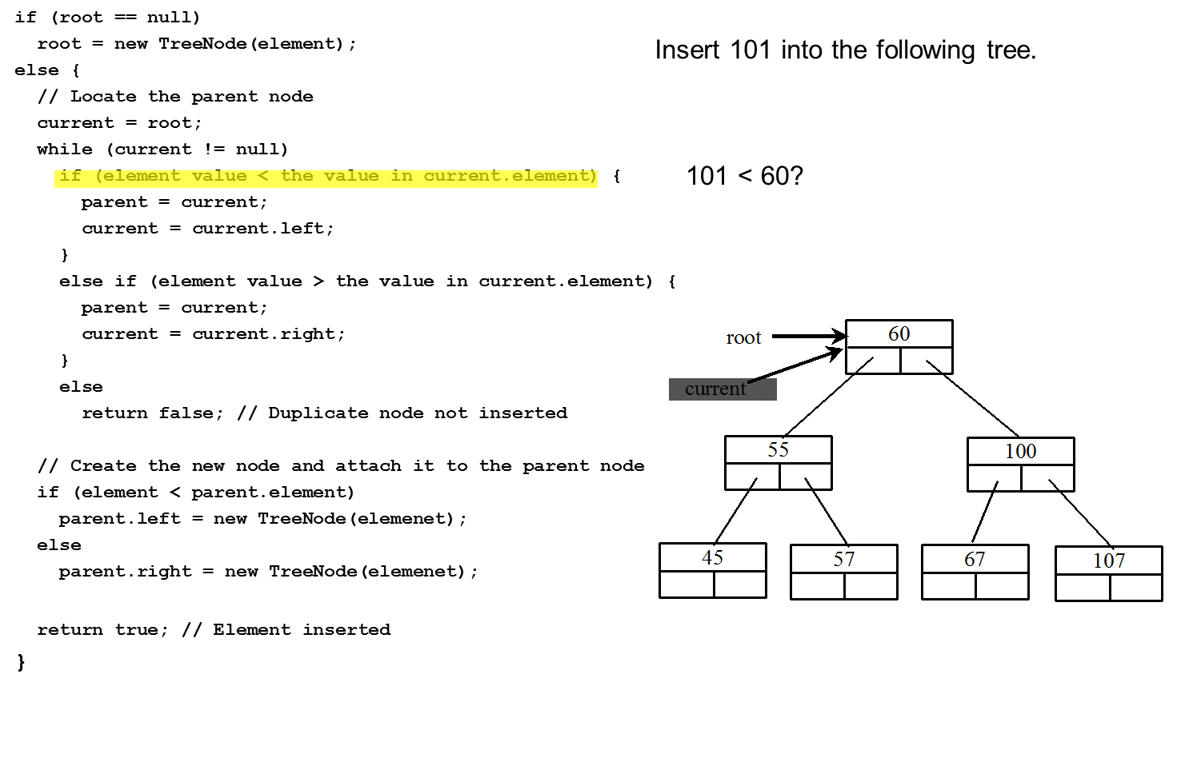
Trace Inserting 101 into the following tree (4 of 20)
Notes:
root = new TreeNode left parenthesis element right parenthesis semi colon
else left brace
forward slash forward slash Locate the parent node
current = root semi colon
while left parenthesis current exclamation mark = null right parenthesis
if left parenthesis element value less than symbol the value in current.element right parenthesis left brace, 101 is less than 60?
parent = current semi colon
current = current.left semi colon
right brace
else if left parenthesis element value greater than symbol the value in current.element right parenthesis left brace
parent = current semi colon
current = current.right semi colon
right brace
else
return false semi colon forward slash forward slash Duplicate node not inserted
forward slash forward slash Create the new node and attach it to the parent node
if left parenthesis element less than symbol parent.element right parenthesis
parent.left = new TreeNode left parenthesis elemenet right parenthesis semi colon
else
parent.right = new TreeNode left parenthesis elemenet right parenthesis semi colon
return true semi colon forward slash forward slash Element inserted
right brace
The seventh line is highlighted.
Insert 101 into the following tree.
A tree diagram shows 60 at the top labeled, root. 60 has branches as 55 and 100. 55 has branches as 45 and 57. 100 has branches as 67 and 107. Each element has two boxes. The left box of 60 is labeled, current.

Slide 42
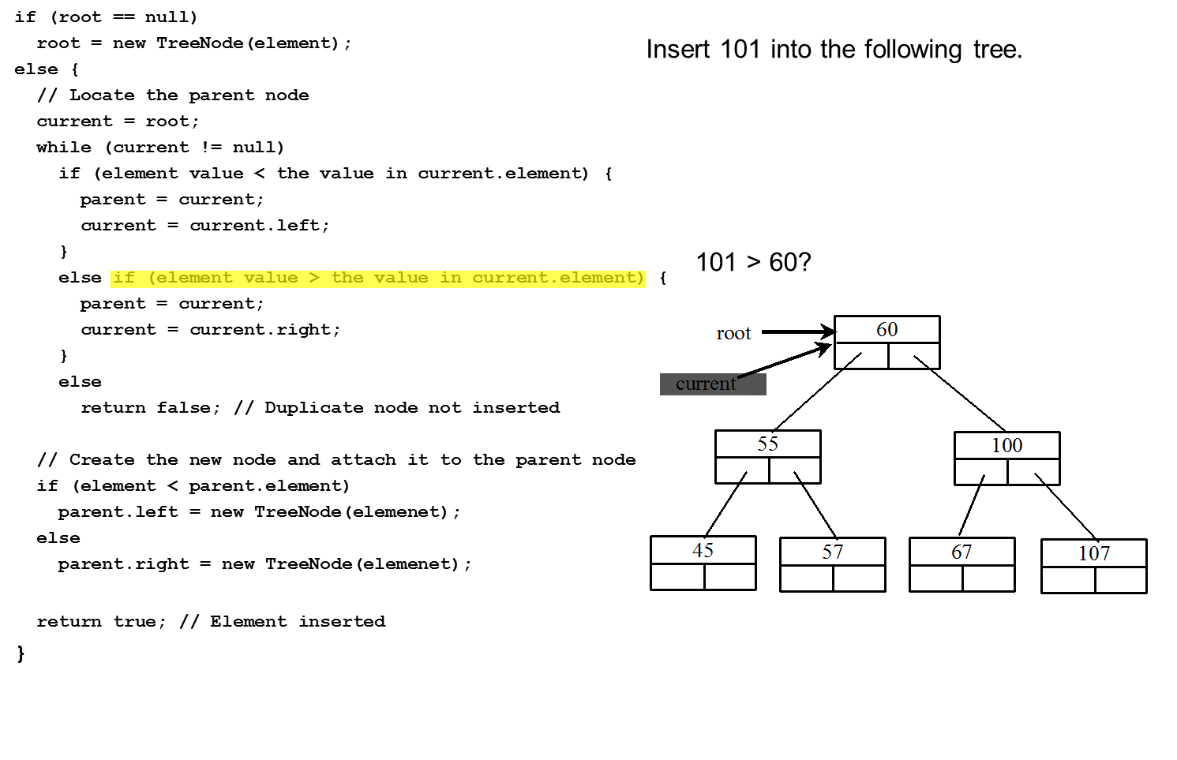
Trace Inserting 101 into the following tree (5 of 20)
Notes:
root = new TreeNode left parenthesis element right parenthesis semi colon
else left brace
forward slash forward slash Locate the parent node
current = root semi colon
while left parenthesis current exclamation mark = null right parenthesis
if left parenthesis element value less than symbol the value in current.element right parenthesis left brace,
parent = current semi colon
current = current.left semi colon
right brace
else if left parenthesis element value greater than symbol the value in current.element right parenthesis left brace, 101 is less than 60?
parent = current semi colon
current = current.right semi colon
right brace
else
return false semi colon forward slash forward slash Duplicate node not inserted
forward slash forward slash Create the new node and attach it to the parent node
if left parenthesis element less than symbol parent.element right parenthesis
parent.left = new TreeNode left parenthesis elemenet right parenthesis semi colon
else
parent.right = new TreeNode left parenthesis elemenet right parenthesis semi colon
return true semi colon forward slash forward slash Element inserted
right brace
The eleventh line is highlighted.
Insert 101 into the following tree.
A tree diagram shows 60 at the top labeled, root. 60 has branches as 55 and 100. 55 has branches as 45 and 57. 100 has branches as 67 and 107. Each element has two boxes. The left box of 60 is labeled, current.

Slide 43
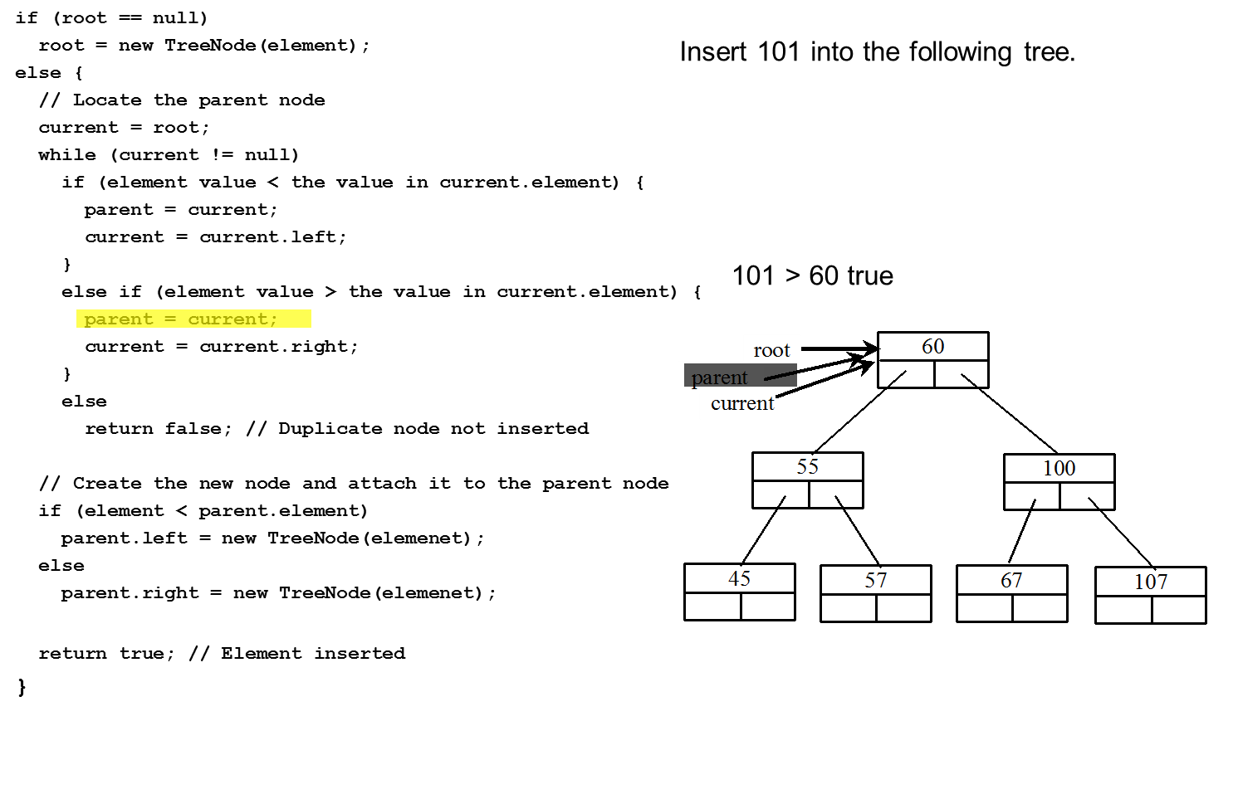
Trace Inserting 101 into the following tree (6 of 20)
Notes:
root = new TreeNode left parenthesis element right parenthesis semi colon
else left brace
forward slash forward slash Locate the parent node
current = root semi colon
while left parenthesis current exclamation mark = null right parenthesis
if left parenthesis element value less than symbol the value in current.element right parenthesis left brace,
parent = current semi colon
current = current.left semi colon
right brace
else if left parenthesis element value greater than symbol the value in current.element right parenthesis left brace, 101 is greater than 60 true
parent = current semi colon
current = current.right semi colon
right brace
else
return false semi colon forward slash forward slash Duplicate node not inserted
forward slash forward slash Create the new node and attach it to the parent node
if left parenthesis element less than symbol parent.element right parenthesis
parent.left = new TreeNode left parenthesis elemenet right parenthesis semi colon
else
parent.right = new TreeNode left parenthesis elemenet right parenthesis semi colon
return true semi colon forward slash forward slash Element inserted
right brace
The Thirteenth line is highlighted.
Insert 101 into the following tree.
A tree diagram shows 60 at the top labeled, root. 60 has branches as 55 and 100. 55 has branches as 45 and 57. 100 has branches as 67 and 107. Each element has two boxes. The left box of 60 is labeled, current. The element is labeled, parent as well.

Slide 44
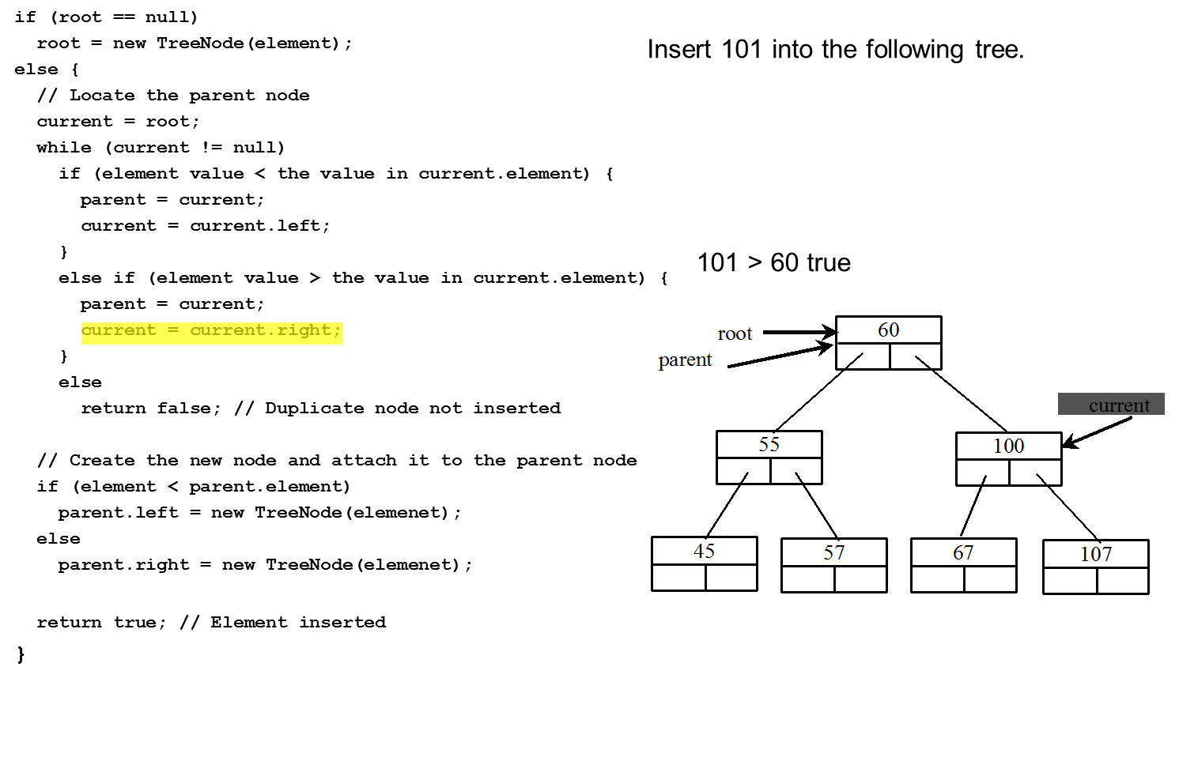
Trace Inserting 101 into the following tree (7 of 20)
Notes:
root = new TreeNode left parenthesis element right parenthesis semi colon
else left brace
forward slash forward slash Locate the parent node
current = root semi colon
while left parenthesis current exclamation mark = null right parenthesis
if left parenthesis element value less than symbol the value in current.element right parenthesis left brace,
parent = current semi colon
current = current.left semi colon
right brace
else if left parenthesis element value greater than symbol the value in current.element right parenthesis left brace, 101 is greater than 60 true
parent = current semi colon
current = current.right semi colon
right brace
else
return false semi colon forward slash forward slash Duplicate node not inserted
forward slash forward slash Create the new node and attach it to the parent node
if left parenthesis element less than symbol parent.element right parenthesis
parent.left = new TreeNode left parenthesis elemenet right parenthesis semi colon
else
parent.right = new TreeNode left parenthesis elemenet right parenthesis semi colon
return true semi colon forward slash forward slash Element inserted
right brace
The thirteenth line is highlighted.
Insert 101 into the following tree.
A tree diagram shows 60 at the top labeled, root. 60 has branches as 55 and 100. 55 has branches as 45 and 57. 100 has branches as 67 and 107. Each element has two boxes. The element is labeled, parent as well. The element 100 is labeled, current.

Slide 45
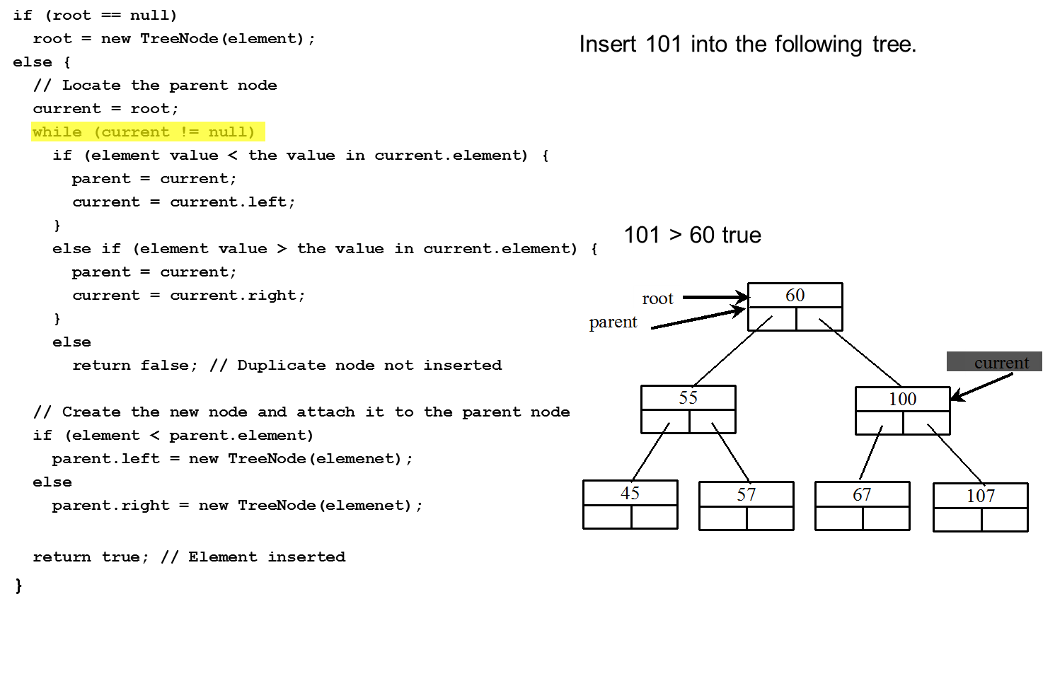
Trace Inserting 101 into the following tree (8 of 20)
Notes:
root = new TreeNode left parenthesis element right parenthesis semi colon
else left brace
forward slash forward slash Locate the parent node
current = root semi colon
while left parenthesis current exclamation mark = null right parenthesis
if left parenthesis element value less than symbol the value in current.element right parenthesis left brace,
parent = current semi colon
current = current.left semi colon
right brace
else if left parenthesis element value greater than symbol the value in current.element right parenthesis left brace, 101 is greater than 60 true
parent = current semi colon
current = current.right semi colon
right brace
else
return false semi colon forward slash forward slash Duplicate node not inserted
forward slash forward slash Create the new node and attach it to the parent node
if left parenthesis element less than symbol parent.element right parenthesis
parent.left = new TreeNode left parenthesis elemenet right parenthesis semi colon
else
parent.right = new TreeNode left parenthesis elemenet right parenthesis semi colon
return true semi colon forward slash forward slash Element inserted
right brace
The sixth line is highlighted.
Insert 101 into the following tree.
A tree diagram shows 60 at the top labeled, root. 60 has branches as 55 and 100. 55 has branches as 45 and 57. 100 has branches as 67 and 107. Each element has two boxes. The element is labeled, parent as well. The element 100 is labeled, current.

Slide 46
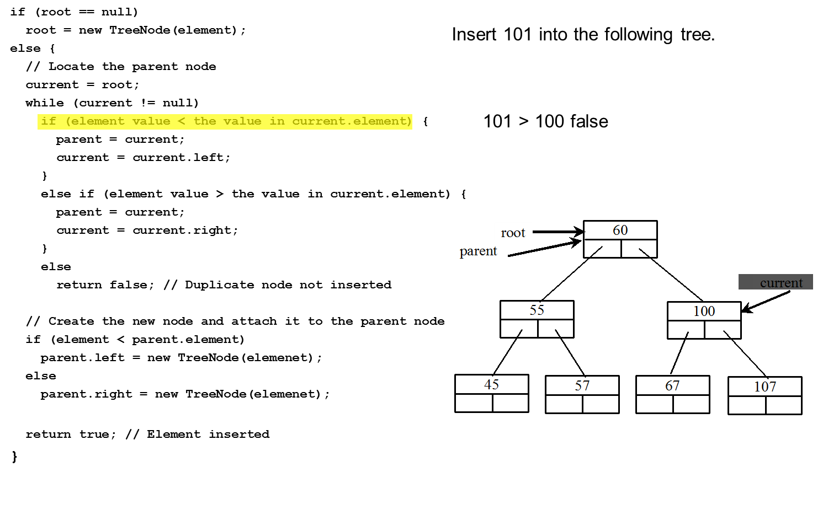
Trace Inserting 101 into the following tree (9 of 20)
Notes:
root = new TreeNode left parenthesis element right parenthesis semi colon
else left brace
forward slash forward slash Locate the parent node
current = root semi colon
while left parenthesis current exclamation mark = null right parenthesis
if left parenthesis element value less than symbol the value in current.element right parenthesis left brace, 101 is greater than 100 false
parent = current semi colon
current = current.left semi colon
right brace
else if left parenthesis element value greater than symbol the value in current.element right parenthesis left brace,
parent = current semi colon
current = current.right semi colon
right brace
else
return false semi colon forward slash forward slash Duplicate node not inserted
forward slash forward slash Create the new node and attach it to the parent node
if left parenthesis element less than symbol parent.element right parenthesis
parent.left = new TreeNode left parenthesis elemenet right parenthesis semi colon
else
parent.right = new TreeNode left parenthesis elemenet right parenthesis semi colon
return true semi colon forward slash forward slash Element inserted
right brace
The seventh line is highlighted.
Insert 101 into the following tree.
A tree diagram shows 60 at the top labeled, root. 60 has branches as 55 and 100. 55 has branches as 45 and 57. 100 has branches as 67 and 107. Each element has two boxes. The element is labeled, parent as well. The element 100 is labeled, current.

Slide 47
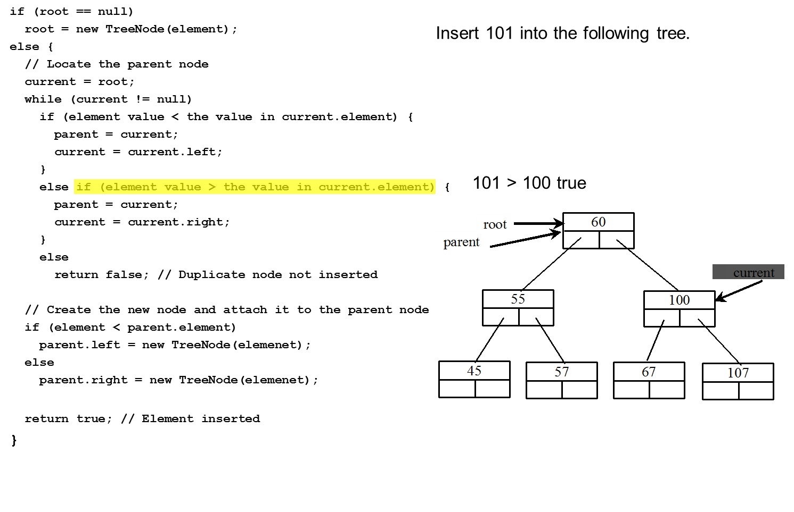
Trace Inserting 101 into the following tree (10 of 20)
Notes:
root = new TreeNode left parenthesis element right parenthesis semi colon
else left brace
forward slash forward slash Locate the parent node
current = root semi colon
while left parenthesis current exclamation mark = null right parenthesis
if left parenthesis element value less than symbol the value in current.element right parenthesis left brace,
parent = current semi colon
current = current.left semi colon
right brace
else if left parenthesis element value greater than symbol the value in current.element right parenthesis left brace, 101 is greater than 100 false
parent = current semi colon
current = current.right semi colon
right brace
else
return false semi colon forward slash forward slash Duplicate node not inserted
forward slash forward slash Create the new node and attach it to the parent node
if left parenthesis element less than symbol parent.element right parenthesis
parent.left = new TreeNode left parenthesis elemenet right parenthesis semi colon
else
parent.right = new TreeNode left parenthesis elemenet right parenthesis semi colon
return true semi colon forward slash forward slash Element inserted
right brace
The eleventh line is highlighted.
Insert 101 into the following tree.
A tree diagram shows 60 at the top labeled, root. 60 has branches as 55 and 100. 55 has branches as 45 and 57. 100 has branches as 67 and 107. Each element has two boxes. The element is labeled, parent as well. The element 100 is labeled, current.

Slide 48
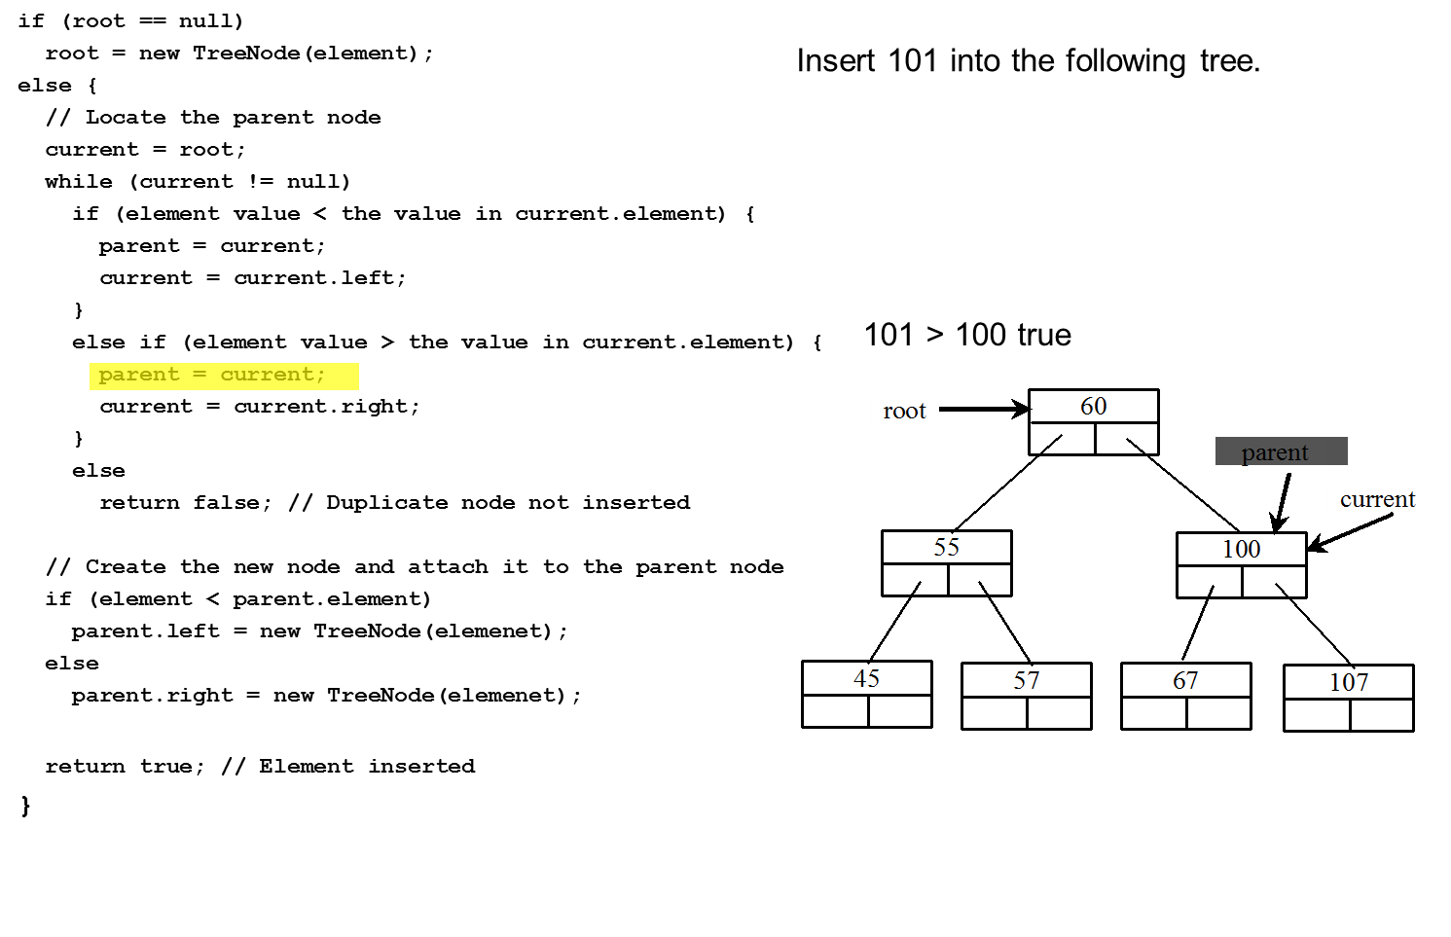
Trace Inserting 101 into the following tree (11 of 20)
Notes:
root = new TreeNode left parenthesis element right parenthesis semi colon
else left brace
forward slash forward slash Locate the parent node
current = root semi colon
while left parenthesis current exclamation mark = null right parenthesis
if left parenthesis element value less than symbol the value in current.element right parenthesis left brace,
parent = current semi colon
current = current.left semi colon
right brace
else if left parenthesis element value greater than symbol the value in current.element right parenthesis left brace, 101 is greater than 100 true
parent = current semi colon
current = current.right semi colon
right brace
else
return false semi colon forward slash forward slash Duplicate node not inserted
forward slash forward slash Create the new node and attach it to the parent node
if left parenthesis element less than symbol parent.element right parenthesis
parent.left = new TreeNode left parenthesis elemenet right parenthesis semi colon
else
parent.right = new TreeNode left parenthesis elemenet right parenthesis semi colon
return true semi colon forward slash forward slash Element inserted
right brace
The Thirteenth line is highlighted.
Insert 101 into the following tree.
A tree diagram shows 60 at the top labeled, root. 60 has branches as 55 and 100. 55 has branches as 45 and 57. 100 has branches as 67 and 107. Each element has two boxes. The element 100 is labeled, current. The element is labeled, parent as well.

Slide 49
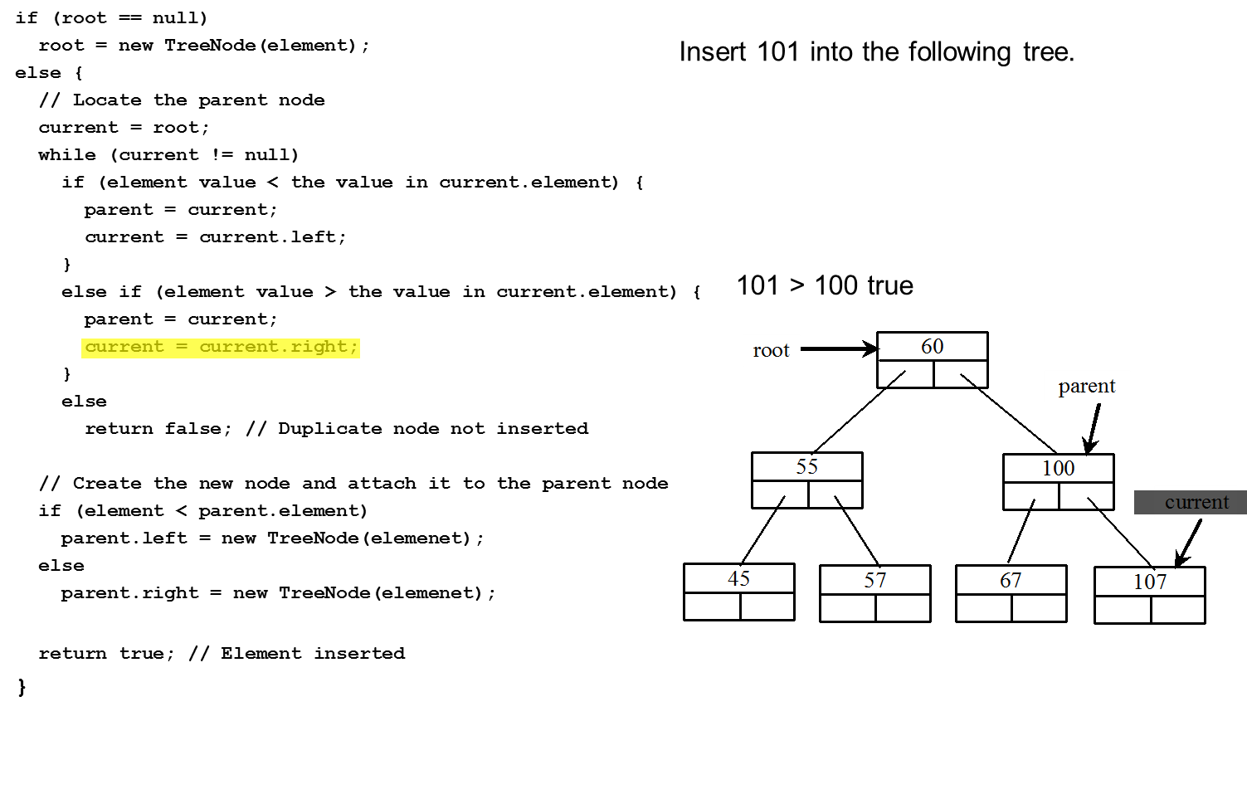
Trace Inserting 101 into the following tree (12 of 20)
Notes:
root = new TreeNode left parenthesis element right parenthesis semi colon
else left brace
forward slash forward slash Locate the parent node
current = root semi colon
while left parenthesis current exclamation mark = null right parenthesis
if left parenthesis element value less than symbol the value in current.element right parenthesis left brace,
parent = current semi colon
current = current.left semi colon
right brace
else if left parenthesis element value greater than symbol the value in current.element right parenthesis left brace, 101 is greater than 100 true
parent = current semi colon
current = current.right semi colon
right brace
else
return false semi colon forward slash forward slash Duplicate node not inserted
forward slash forward slash Create the new node and attach it to the parent node
if left parenthesis element less than symbol parent.element right parenthesis
parent.left = new TreeNode left parenthesis elemenet right parenthesis semi colon
else
parent.right = new TreeNode left parenthesis elemenet right parenthesis semi colon
return true semi colon forward slash forward slash Element inserted
right brace
The thirteenth line is highlighted.
Insert 101 into the following tree.
A tree diagram shows 60 at the top labeled, root. 60 has branches as 55 and 100. 55 has branches as 45 and 57. 100 has branches as 67 and 107. Each element has two boxes. The element 100 is labeled, parent. The element 107 is labeled, current.

Slide 50
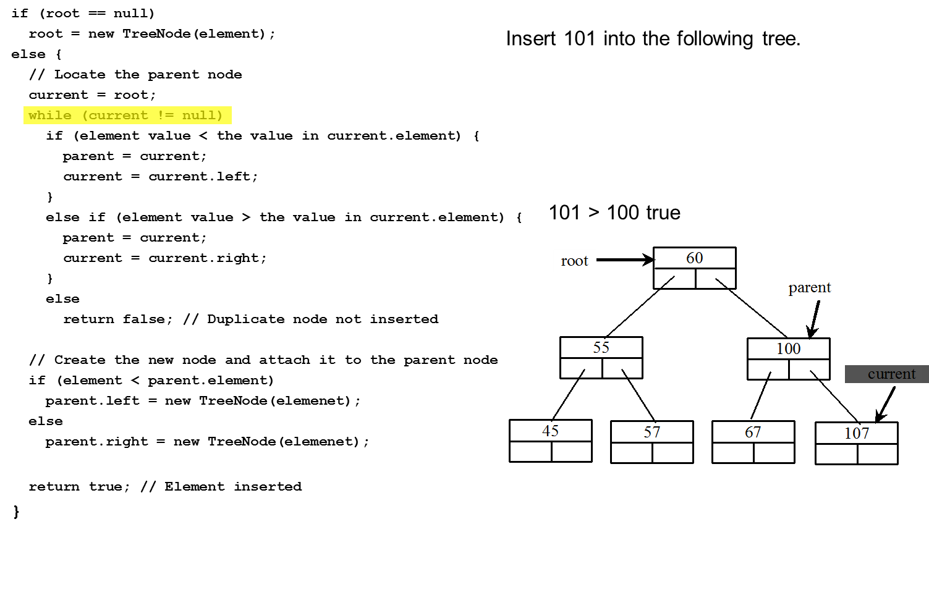
Trace Inserting 101 into the following tree (13 of 20)
Notes:
root = new TreeNode left parenthesis element right parenthesis semi colon
else left brace
forward slash forward slash Locate the parent node
current = root semi colon
while left parenthesis current exclamation mark = null right parenthesis
if left parenthesis element value less than symbol the value in current.element right parenthesis left brace,
parent = current semi colon
current = current.left semi colon
right brace
else if left parenthesis element value greater than symbol the value in current.element right parenthesis left brace, 101 is greater than 100 true
parent = current semi colon
current = current.right semi colon
right brace
else
return false semi colon forward slash forward slash Duplicate node not inserted
forward slash forward slash Create the new node and attach it to the parent node
if left parenthesis element less than symbol parent.element right parenthesis
parent.left = new TreeNode left parenthesis elemenet right parenthesis semi colon
else
parent.right = new TreeNode left parenthesis elemenet right parenthesis semi colon
return true semi colon forward slash forward slash Element inserted
right brace
The sixth line is highlighted.
Insert 101 into the following tree.
A tree diagram shows 60 at the top labeled, root. 60 has branches as 55 and 100. 55 has branches as 45 and 57. 100 has branches as 67 and 107. Each element has two boxes. The element 100 is labeled, parent. The element 107 is labeled, current.

Slide 51
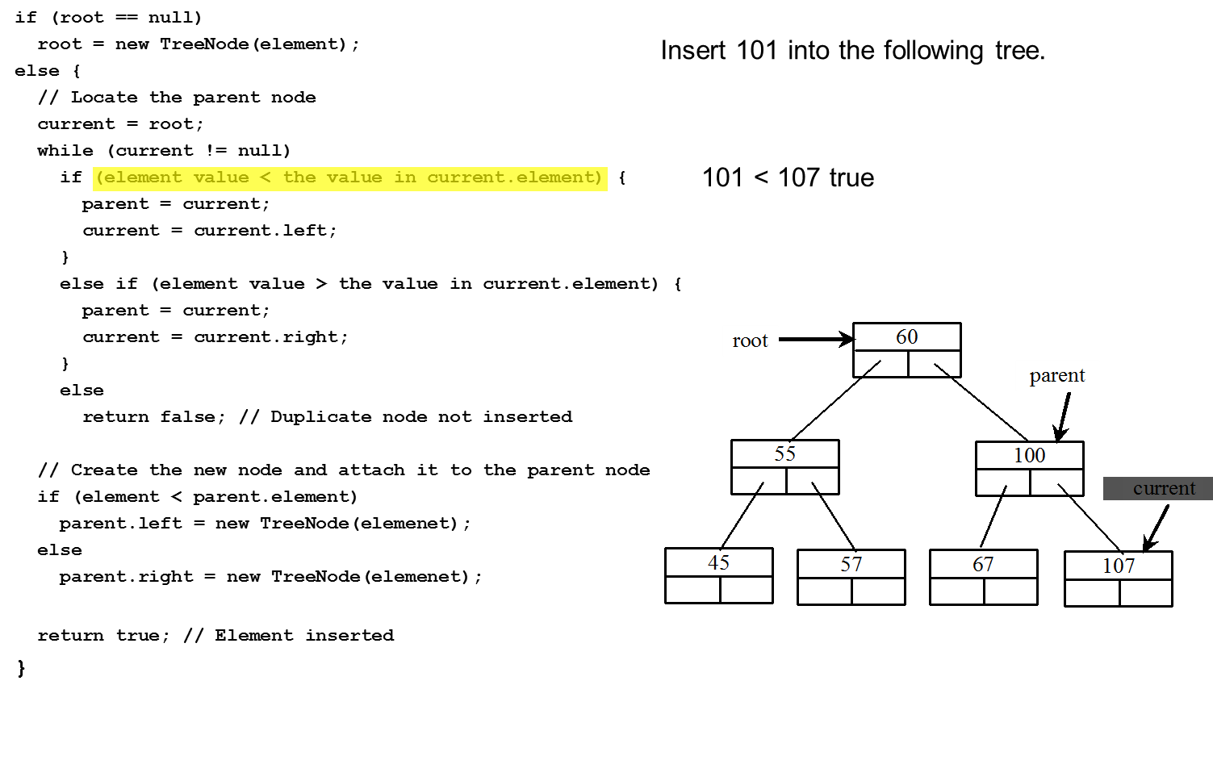
Trace Inserting 101 into the following tree (14 of 20)
Notes:
root = new TreeNode left parenthesis element right parenthesis semi colon
else left brace
forward slash forward slash Locate the parent node
current = root semi colon
while left parenthesis current exclamation mark = null right parenthesis
if left parenthesis element value less than symbol the value in current.element right parenthesis left brace, 101 is less than 107 true
parent = current semi colon
current = current.left semi colon
right brace
else if left parenthesis element value greater than symbol the value in current.element right parenthesis left brace,
parent = current semi colon
current = current.right semi colon
right brace
else
return false semi colon forward slash forward slash Duplicate node not inserted
forward slash forward slash Create the new node and attach it to the parent node
if left parenthesis element less than symbol parent.element right parenthesis
parent.left = new TreeNode left parenthesis elemenet right parenthesis semi colon
else
parent.right = new TreeNode left parenthesis elemenet right parenthesis semi colon
return true semi colon forward slash forward slash Element inserted
right brace
The seventh line is highlighted.
Insert 101 into the following tree.
A tree diagram shows 60 at the top labeled, root. 60 has branches as 55 and 100. 55 has branches as 45 and 57. 100 has branches as 67 and 107. Each element has two boxes. The element 100 is labeled, parent. The element 107 is labeled, current.

Slide 52
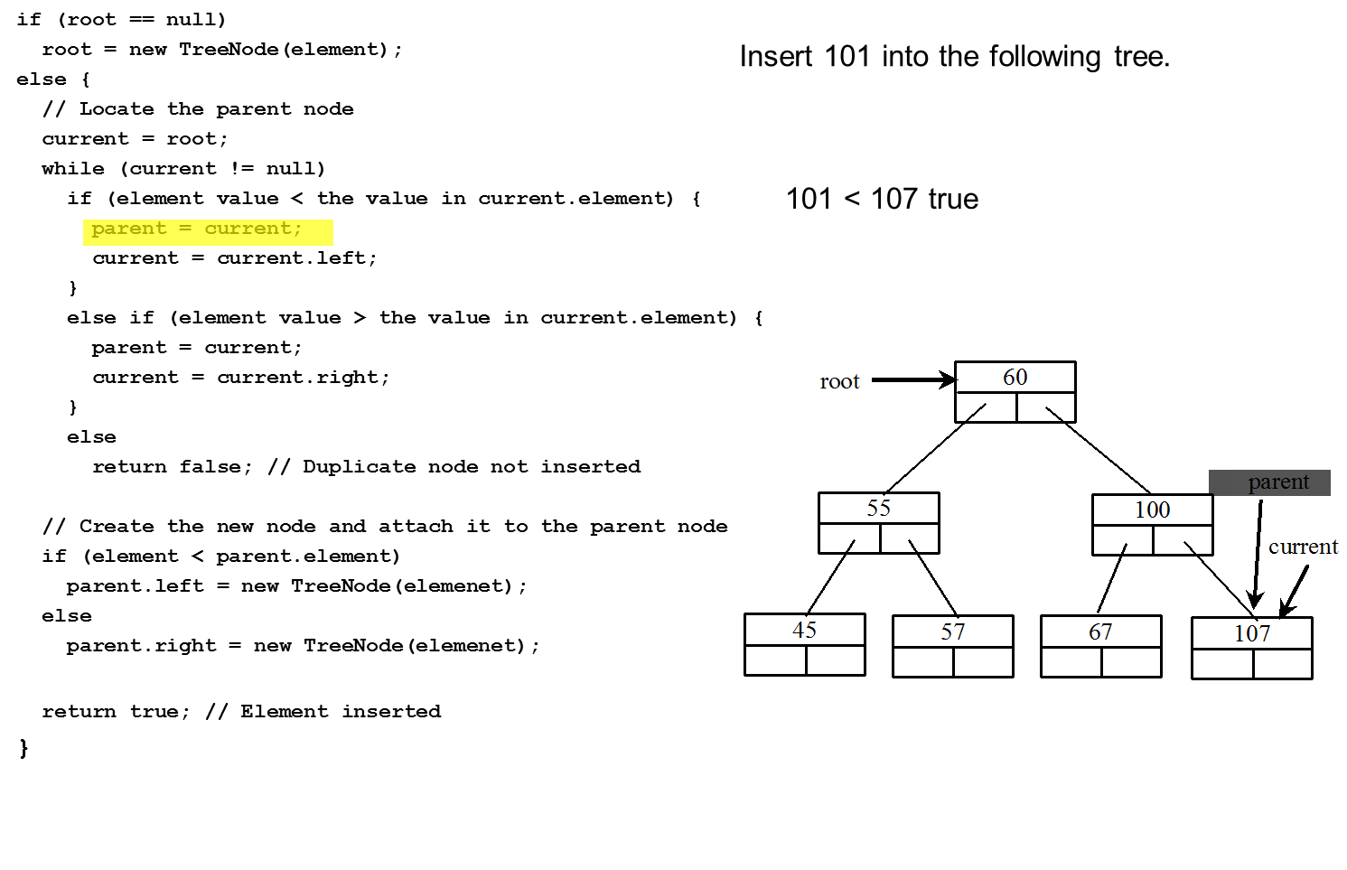
Trace Inserting 101 into the following tree (15 of 20)
Notes:
root = new TreeNode left parenthesis element right parenthesis semi colon
else left brace
forward slash forward slash Locate the parent node
current = root semi colon
while left parenthesis current exclamation mark = null right parenthesis
if left parenthesis element value less than symbol the value in current.element right parenthesis left brace, 101 is less than 107 true
parent = current semi colon
current = current.left semi colon
right brace
else if left parenthesis element value greater than symbol the value in current.element right parenthesis left brace,
parent = current semi colon
current = current.right semi colon
right brace
else
return false semi colon forward slash forward slash Duplicate node not inserted
forward slash forward slash Create the new node and attach it to the parent node
if left parenthesis element less than symbol parent.element right parenthesis
parent.left = new TreeNode left parenthesis elemenet right parenthesis semi colon
else
parent.right = new TreeNode left parenthesis elemenet right parenthesis semi colon
return true semi colon forward slash forward slash Element inserted
right brace
The eighth line is highlighted.
Insert 101 into the following tree.
A tree diagram shows 60 at the top labeled, root. 60 has branches as 55 and 100. 55 has branches as 45 and 57. 100 has branches as 67 and 107. Each element has two boxes. The element 107 is labeled, parent. The element 107 is labeled, current as well.

Slide 53
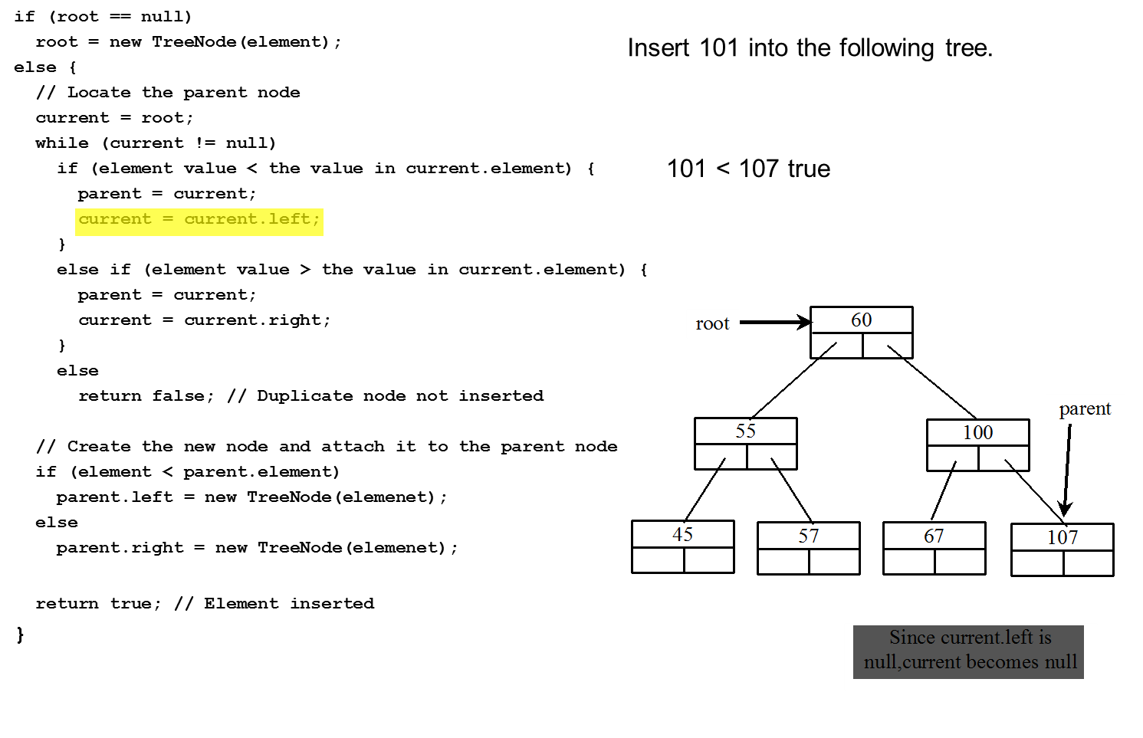
Trace Inserting 101 into the following tree (16 of 20)
Notes:
root = new TreeNode left parenthesis element right parenthesis semi colon
else left brace
forward slash forward slash Locate the parent node
current = root semi colon
while left parenthesis current exclamation mark = null right parenthesis
if left parenthesis element value less than symbol the value in current.element right parenthesis left brace, 101 is less than 107 true
parent = current semi colon
current = current.left semi colon
right brace
else if left parenthesis element value greater than symbol the value in current.element right parenthesis left brace,
parent = current semi colon
current = current.right semi colon
right brace
else
return false semi colon forward slash forward slash Duplicate node not inserted
forward slash forward slash Create the new node and attach it to the parent node
if left parenthesis element less than symbol parent.element right parenthesis
parent.left = new TreeNode left parenthesis elemenet right parenthesis semi colon
else
parent.right = new TreeNode left parenthesis elemenet right parenthesis semi colon
return true semi colon forward slash forward slash Element inserted
right brace
The ninth line is highlighted.
Insert 101 into the following tree.
A tree diagram shows 60 at the top labeled, root. 60 has branches as 55 and 100. 55 has branches as 45 and 57. 100 has branches as 67 and 107. Each element has two boxes. The element 107 is labeled, parent. The text reads, current.left is null, current becomes null.

Slide 54
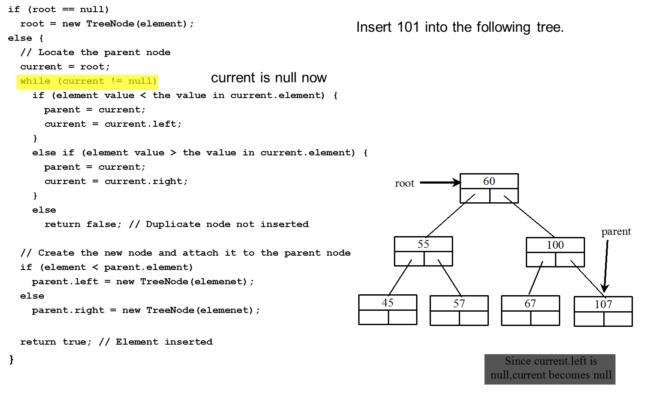
Trace Inserting 101 into the following tree (17 of 20)
Notes:
root = new TreeNode left parenthesis element right parenthesis semi colon
else left brace
forward slash forward slash Locate the parent node
current = root semi colon
while left parenthesis current exclamation mark = null right parenthesis, current is null now
if left parenthesis element value less than symbol the value in current.element right parenthesis left brace,
parent = current semi colon
current = current.left semi colon
right brace
else if left parenthesis element value greater than symbol the value in current.element right parenthesis left brace,
parent = current semi colon
current = current.right semi colon
right brace
else
return false semi colon forward slash forward slash Duplicate node not inserted
forward slash forward slash Create the new node and attach it to the parent node
if left parenthesis element less than symbol parent.element right parenthesis
parent.left = new TreeNode left parenthesis elemenet right parenthesis semi colon
else
parent.right = new TreeNode left parenthesis elemenet right parenthesis semi colon
return true semi colon forward slash forward slash Element inserted
right brace
The sixth line is highlighted.
Insert 101 into the following tree.
A tree diagram shows 60 at the top labeled, root. 60 has branches as 55 and 100. 55 has branches as 45 and 57. 100 has branches as 67 and 107. Each element has two boxes. The element 107 is labeled, parent. The text reads, current.left is null, current becomes null.

Slide 55
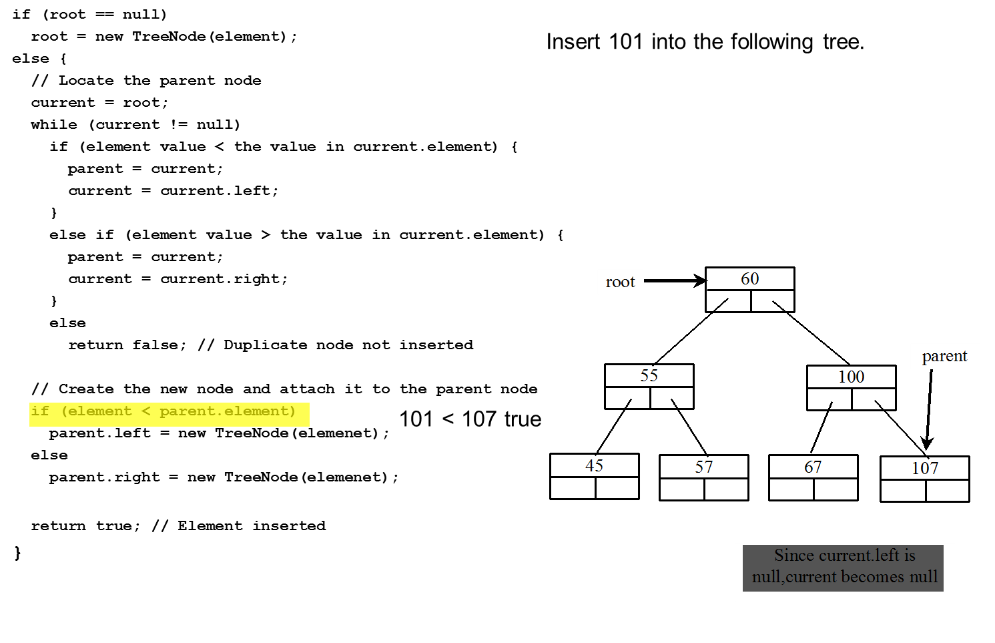
Trace Inserting 101 into the following tree (18 of 20)
Notes:
root = new TreeNode left parenthesis element right parenthesis semi colon
else left brace
forward slash forward slash Locate the parent node
current = root semi colon
while left parenthesis current exclamation mark = null right parenthesis
if left parenthesis element value less than symbol the value in current.element right parenthesis left brace,
parent = current semi colon
current = current.left semi colon
right brace
else if left parenthesis element value greater than symbol the value in current.element right parenthesis left brace,
parent = current semi colon
current = current.right semi colon
right brace
else
return false semi colon forward slash forward slash Duplicate node not inserted
forward slash forward slash Create the new node and attach it to the parent node
if left parenthesis element less than symbol parent.element right parenthesis, 101 is less than 107 true
parent.left = new TreeNode left parenthesis elemenet right parenthesis semi colon
else
parent.right = new TreeNode left parenthesis elemenet right parenthesis semi colon
return true semi colon forward slash forward slash Element inserted
right brace
The eighteenth line is highlighted.
Insert 101 into the following tree.
60 at the top labeled, root. 60 has branches as 55 and 100. 55 has branches as 45 and 57. 100 has branches as 67 and 107. Each element has two boxes. The element 107 is labeled, parent. The text reads, current.left is null, current becomes null.

Slide 56
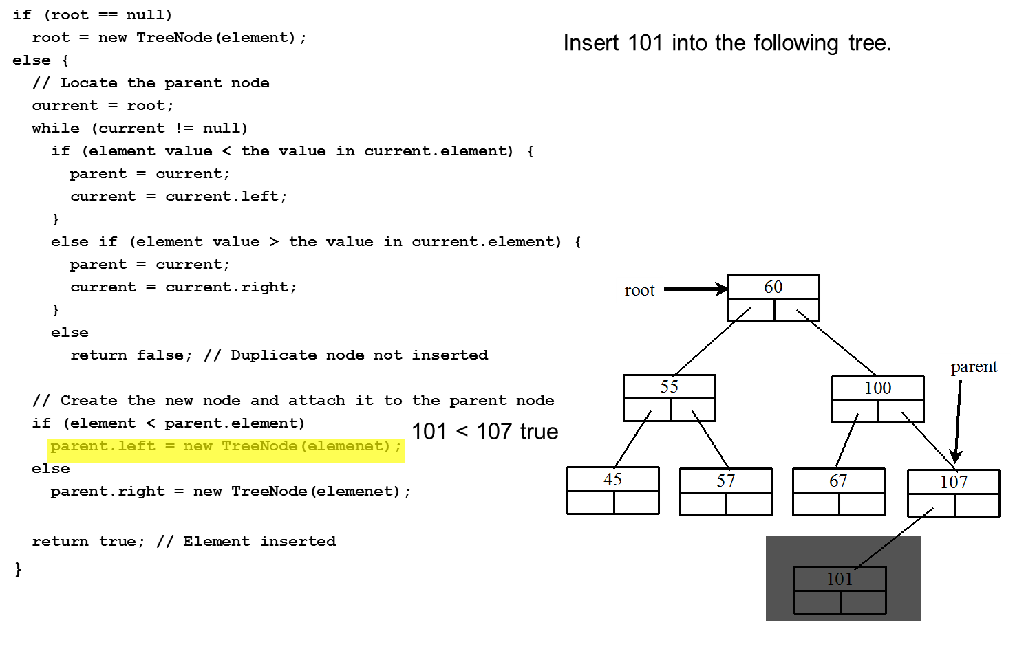
Trace Inserting 101 into the following tree (19 of 20)
Notes:
root = new TreeNode left parenthesis element right parenthesis semi colon
else left brace
forward slash forward slash Locate the parent node
current = root semi colon
while left parenthesis current exclamation mark = null right parenthesis
if left parenthesis element value less than symbol the value in current.element right parenthesis left brace,
parent = current semi colon
current = current.left semi colon
right brace
else if left parenthesis element value greater than symbol the value in current.element right parenthesis left brace,
parent = current semi colon
current = current.right semi colon
right brace
else
return false semi colon forward slash forward slash Duplicate node not inserted
forward slash forward slash Create the new node and attach it to the parent node
if left parenthesis element less than symbol parent.element right parenthesis, 101 is less than 107 true
parent.left = new TreeNode left parenthesis elemenet right parenthesis semi colon
else
parent.right = new TreeNode left parenthesis elemenet right parenthesis semi colon
return true semi colon forward slash forward slash Element inserted
right brace
The nineteenth line is highlighted.
Insert 101 into the following tree.
A tree diagram shows 60 at the top labeled, root. 60 has branches as 55 and 100. 55 has branches as 45 and 57. 100 has branches as 67 and 107. Each element has two boxes. The element 107 is labeled, parent. The left box of 107 has branch as 101.

Slide 57
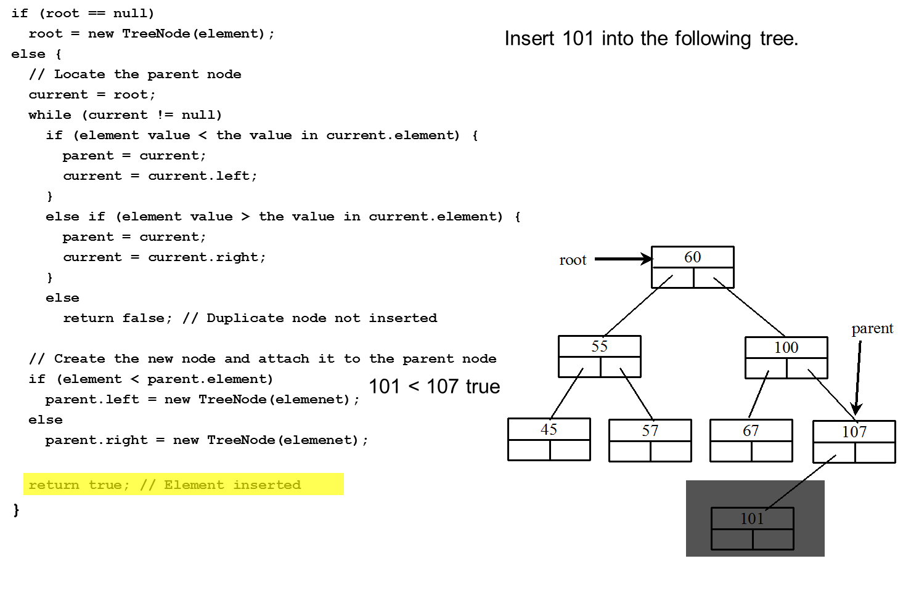
Trace Inserting 101 into the following tree (20 of 20)
Notes:
root = new TreeNode left parenthesis element right parenthesis semi colon
else left brace
forward slash forward slash Locate the parent node
current = root semi colon
while left parenthesis current exclamation mark = null right parenthesis
if left parenthesis element value less than symbol the value in current.element right parenthesis left brace,
parent = current semi colon
current = current.left semi colon
right brace
else if left parenthesis element value greater than symbol the value in current.element right parenthesis left brace,
parent = current semi colon
current = current.right semi colon
right brace
else
return false semi colon forward slash forward slash Duplicate node not inserted
forward slash forward slash Create the new node and attach it to the parent node
if left parenthesis element less than symbol parent.element right parenthesis, 101 is less than 107 true
parent.left = new TreeNode left parenthesis elemenet right parenthesis semi colon
else
parent.right = new TreeNode left parenthesis elemenet right parenthesis semi colon
return true semi colon forward slash forward slash Element inserted
right brace
The second last line is highlighted.
Insert 101 into the following tree.
A tree diagram shows 60 at the top labeled, root. 60 has branches as 55 and 100. 55 has branches as 45 and 57. 100 has branches as 67 and 107. Each element has two boxes. The element 107 is labeled, parent. The left box of 107 has branch as 101.

Slide 58
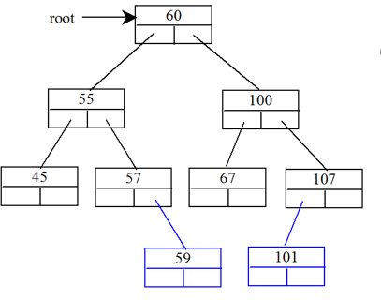
Inserting 59 into the Tree (Recursion)
Notes:
root = new TreeNode left parenthesis element right parenthesis semi colon
else left brace
forward slash forward slash Locate the parent node
current = root semi colon
while left parenthesis current exclamation mark = null right parenthesis
if left parenthesis element value less than symbol the value in current.element right parenthesis left brace,
parent = current semi colon
current = current.left semi colon
right brace
else if left parenthesis element value greater than symbol the value in current.element right parenthesis left brace,
parent = current semi colon
current = current.right semi colon
right brace
else
return false semi colon forward slash forward slash Duplicate node not inserted
forward slash forward slash Create the new node and attach it to the parent node
if left parenthesis element less than symbol parent.element right parenthesis
parent.left = new TreeNode left parenthesis elemenet right parenthesis semi colon
else
parent.right = new TreeNode left parenthesis elemenet right parenthesis semi colon
return true semi colon forward slash forward slash Element inserted
right brace
Insert 101 into the following tree.
A tree diagram shows 60 at the top labeled, root. 60 has branches as 55 and 100. 55 has branches as 45 and 57. 100 has branches as 67 and 107. Each element has two boxes. The left box of 107 has branch as 101 and right box of 57 has branch as 59.

Slide 59
Deletion in BST
12
5
15
2
9
20
7
10
17
30
Why might deletion be harder than insertion?
Notes:
And now for something completely different.
Let’s say I want to delete a node. Why might it be harder than insertion?
Might happen in the middle of the tree instead of at leaf.
Then, I have to fix the BST.

Slide 60
Deletion
Removing an item disrupts the tree structure
Basic idea:
find the node to be removed (current) and also its parent node (parent)
Current node may be a left child or a right child of the parent node
Remove it
Fix the tree so that it is still a BST
Two cases:
node has no left child
Leaf (no right child)
node has left child
Internal node
12
5
15
2
9
20
7
10
17
30

Slide 61
Deleting Elements in a Binary Search Tree
Case 1: The current node does not have a left child, as shown in this figure (a). Simply connect the parent with the right child of the current node, as shown in this figure (b).
Notes:
The first tree diagram shows a blank element labeled, parent. The element is labeled, current may be a left or right child of parent. This element has branch as current labeled, current points the node to be deleted. Current has braches as no left child and subtree. The second tree diagram shows a blank element labeled, parent. The element has branch as subtree. The line connecting the two elements is labeled, Subtree may be a left or right subtree of parent.

Slide 62
Deleting Elements in a Binary Search Tree
For example, to delete node 10. Connect the parent of node 10 with the right child of node 10.
Notes:
The first tree diagram shows 20 at the top labeled, root. 20 has branch on the left as 10 and branch on the right as 40. 10 has branch on the right as 16. 40 has branch on the left as 30 and on the right as 80. 30 has branch on the left as 27 and 80 has branch on the left as 50. The second tree diagram shows 20 at the top labeled, root. 20 has branch on the left as 16. 40 has branch on the left as 30 and on the right as 80. 30 has branch on the left as 27 and 80 has branch on the left as 50.

Slide 63
Case 1: Delete 15
12
12
5
15
5
20
2
9
20
2
9
30
7
10
30
7
10
delete(15)
Notes:
Single child nodes we remove and…
Do what?
We can just pull up their children.
Is the search tree property intact?
Yes.

Slide 64
Deletion – The Two Child Case
Idea: Replace the deleted node with a value guaranteed to be between the node's two child subtrees
Options are
successor from right subtree
predecessor from left subtree
These are the easy cases of predecessor/successor
Either option is fine as both are guaranteed to exist in this case

Slide 65
Deleting Elements in a Binary Search Tree
Case 2: The current node has a left child. Let rightMost point to the node that contains the largest element in the left subtree of the current node and parentOfRightMost point to the parent node of the rightMost node. Note that the rightMost node cannot have a right child, but may have a left child. Replace the element value in the current node with the one in the rightMost node, connect the parentOfRightMost node with the left child of the rightMost node, and delete the rightMost node.

Slide 66
Deleting Elements in a Binary Search Tree
Case 2 diagram
Notes:
The diagram shows two tree diagrams, each with element at the top labeled, parent with a blank branch labeled, current. In the first diagram, the current is labeled, the content of the current node is replaced by content by the content of the right-most node. The right-most node is deleted. The current has branch on the left as a blank element and branch on the right as right subtree. The blank element has branch on the right labeled, parentOfRightMost. The branch on the right of parentOfRightMost is labeled, rightmost. The branch on the left of rightmost is leftChildOfRightMost. In the second diagram, the current is labeled, current may be a left or right child of parent and current points the node to be deleted. The current has branch on the left as a blank element and branch on the right as right subtree. The blank element has branch on the right labeled, parentOfRightMost. The branch on the right of parentOfRightMost is labeled, leftChildOfRightMost. A blank element is labeled, content copied to current and the node deleted.

Slide 67
Deleting Elements in a Binary Search Tree
Case 2 example, delete 20
Notes:
The first tree diagram shows 20 at the top labeled, root. 20 has branch on the left as 10 and branch on the right as 40. 10 has branch on the right as 16 labeled, rightMost. 16 has branch on the left as 14. 40 has branch on the left as 30 and on the right as 80. 30 has branch on the left as 27 and 80 has branch on the left as 50. The second tree diagram shows 16 at the top labeled, root. 16 has branch on the left as 10 and branch on the right as 40. 10 has branch on the right as 14. 40 has branch on the left as 30 and on the right as 80. 30 has branch on the left as 27 and 80 has branch on the left as 50.

Slide 68
Examples (1 of 3)

Slide 69
Examples (2 of 3)

Slide 70
Examples (3 of 3)
Notes:
TestBSTDelete: https://liveexample.pearsoncmg.com/html/TestBSTDelete.html

Slide 71
Deleting Elements in a Binary Search Tree
To delete an element from a binary tree:
First locate the node that contains the element and also its parent node.
Let current point to the node that contains the element in the binary tree
parent point to the parent of the current node.
The current node may be a left child or a right child of the parent node.
There are three cases to consider:
The node to be deleted is a leaf (has no children)
The node to be deleted has one child
The node to be deleted has two children
* Return false if the element is not in the tree */
public boolean delete(E e) {
// Locate the node to be deleted and also locate its parent node
TreeNode<E> parent = null;
TreeNode<E> current = root;
while (current != null) {
if (e.compareTo(current.element) < 0) {
parent = current;
current = current.left;
}
else if (e.compareTo(current.element) > 0) {
parent = current;
current = current.right;
}
else
break; // Element is in the tree pointed by current
}
if (current == null)
return false; // Element is not in the tree

Slide 72
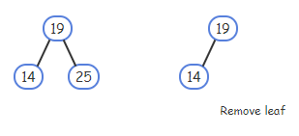
Deleting Elements in a Binary Search Tree
Case 1: The node to be deleted has no left child
Change the appropriate child field of the node’s parent to point to null
// Case 1: current has no left child
if (current.left == null ) {
// Connect the parent with the right child of current
if (parent == null) {
root = current.right;
}
else if (e < parent.element)
parent.left = current.right;
else
parent.right = current.right;
}
else
{ // case 2
delete 25
parent
current

Slide 73
Deleting Elements in a Binary Search Tree
Case 2: The node to be deleted has left child
Find predecessor: RightMost child in the left subtree of current node
Copy predecessor to current nod
Remove predecessor from right subtree

Slide 74
Case 2
TreeNode<E> parentOfRightMost = current; TreeNode<E> rightMost = current.left;
// Keep going to the right while (rightMost.right != null) { parentOfRightMost = rightMost; rightMost = rightMost.right; } // Replace the element in current by the element in
// rightMost current.element = rightMost.element; // Eliminate rightmost node if (parentOfRightMost.right == rightMost) parentOfRightMost.right = rightMost.left; else // Special case: parentOfRightMost == current parentOfRightMost.left = rightMost.left; } size--; return true; // Element deleted }

Slide 75
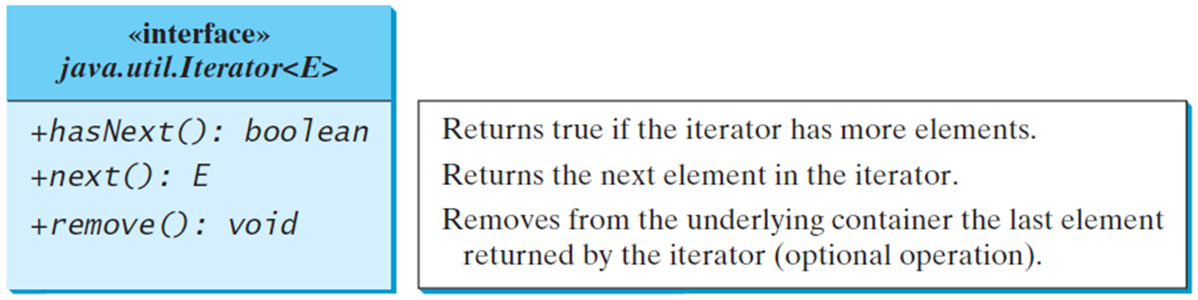
Iterators
An iterator is an object that provides a uniform way for traversing the elements in a container such as a set, list, binary tree, etc.
TestBSTWithIterator
Notes:
+hasNext left parenthesis right parenthesis colon boo7ean. Returns true if the iterator has more elements.
+next0 colon E. Returns the next element in the iterator.
+remove left parenthesis right parenthesis colon void. Removes from the underlying container the last element returned by the iterator (optional operation).
TestBSTWithIterator: https://liveexample.pearsoncmg.com/html/TestBSTWithIterator.html

Slide 76
binary tree time complexity
It is obvious that the time complexity for the inorder, preorder, and postorder is O(n), since each node is traversed only once. The time complexity for search, insertion and deletion is the height of the tree. In the worst case, the height of the tree is O(n).

Slide 77
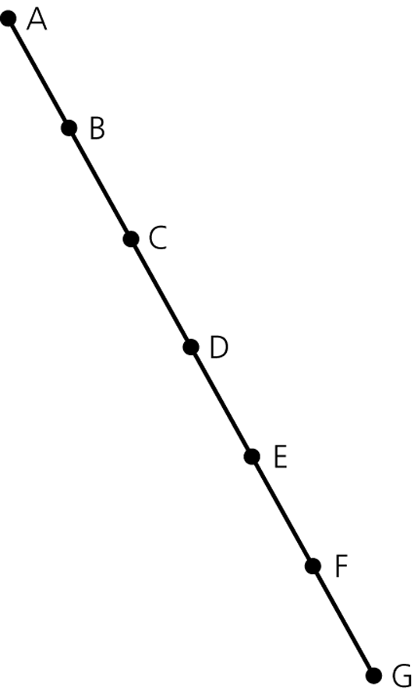
The Efficiency of Binary Search Tree Operations
The maximum number of comparisons for a retrieval, insertion, or deletion is the height of the tree
The maximum and minimum heights of a binary search tree
n is the maximum height of a binary tree with n nodes
A maximum-height binary tree with seven nodes

Slide 78
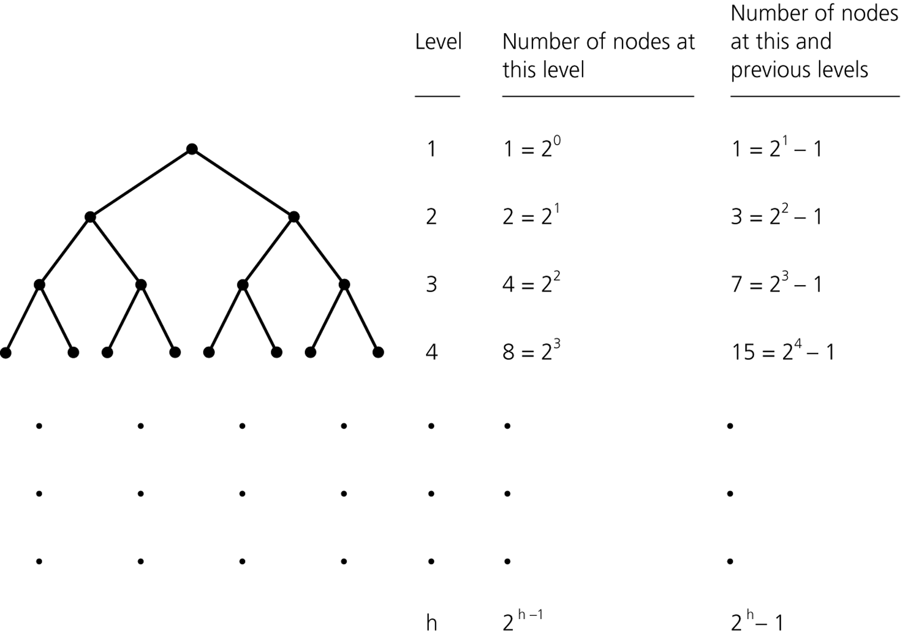
The Efficiency of Binary Search Tree Operations
Theorem
A full binary tree of height h ≥ 0 has 2^{h} – 1 nodes
Theorem
The maximum number of nodes that a binary tree of height h can have is 2^{h} – 1
Counting the nodes in a full binary tree of height h

Slide 79
Summary
Binary search trees come in many shapes
The height of a binary search tree with n nodes can range from a minimum of ⎡log₂(n + 1)⎤ to a maximum of n
The shape of a binary search tree determines the efficiency of its operations
An inorder traversal of a binary search tree visits the tree’s nodes in sorted search-key order
The treesort algorithm efficiently sorts an array by using the binary search tree’s insertion and traversal operations

Slide 80
Review
What is the maximum number of nodes in a binary tree with 8 levels?
What is the maximum and minimum number of levels of a tree with 2011 nodes?
What is the max and min number of leaves of a tree with 10 levels?

Slide 81
Treesort
Treesort
Uses the ADT binary search tree to sort an array of records into search-key order
Efficiency
Average case: O(n * log n)
Worst case: O(n²)

Slide 82
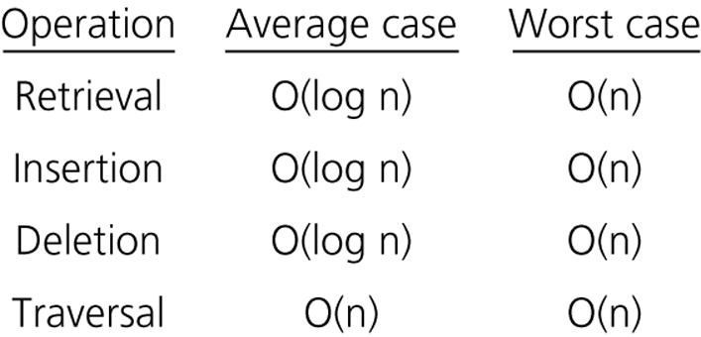
The Efficiency of Binary Search Tree Operations
Theorem 11-4
The minimum height of a binary tree with n nodes is ⎡log₂(n+1)⎤
The height of a particular binary search tree depends on the order in which insertion and deletion operations are performed
Figure 11-34
The order of the retrieval, insertion, deletion, and traversal operations for the reference-based implementation of the ADT binary search tree

